Slide 1
Majart Al-Ma'arifah

Slide 2
The Problem
Children aged 4 to 10 increasingly use mobile devices, exposing them to non-educational or harmful content. There is a shortage of Arabic-language educational apps, especially in conflict zones.

Slide 3
Objectives

Slide 4
1. Main Objective:
Enhance children's cognitive and academic skills with interactive educational games.

Slide 5
2. Sub-Objectives:
Improve reading, writing, and math.
Design engaging educational games.
Foster curiosity and love for learning.
Provide a safe Arabic-language learning environment.

Slide 6
Literature Review

Slide 7
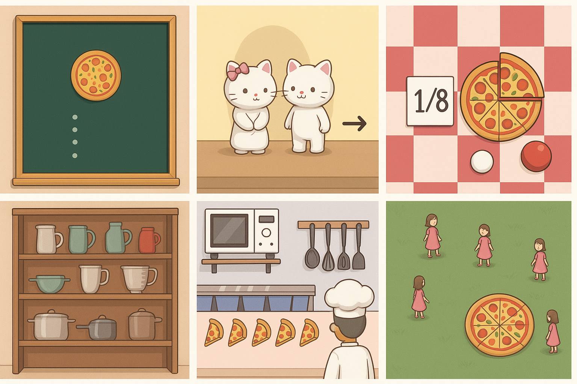
1. Monster Pizza Mobile Learning Game (Sari et al., 2024)
Teaches fractional concepts to elementary school students.
Research and Development approach used for design and evaluation.
Strong potential as an instructional tool with room for improvement.

Slide 8
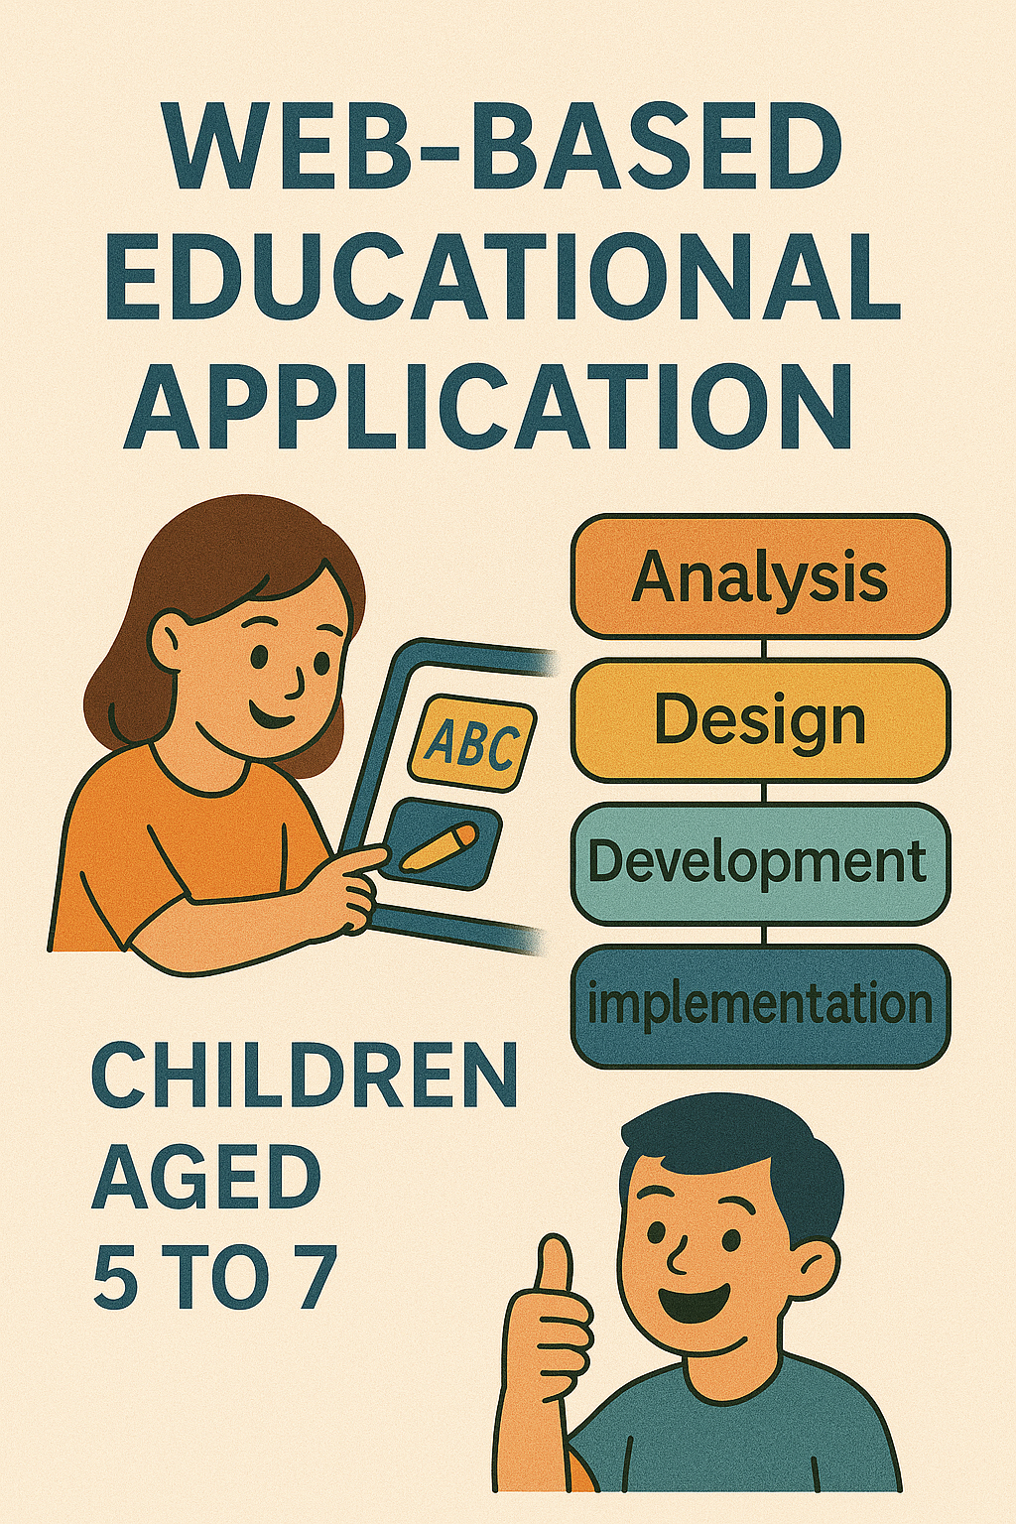
2. Web-Based Educational Application ( Nur Fadzilah Ahmad, et al., 2024)
ADDIE instructional design model applied for children aged 5-7.
Improvements in motivation, focus, and learning outcomes observed.
Positive user feedback on usability and learning effectiveness.

Slide 9
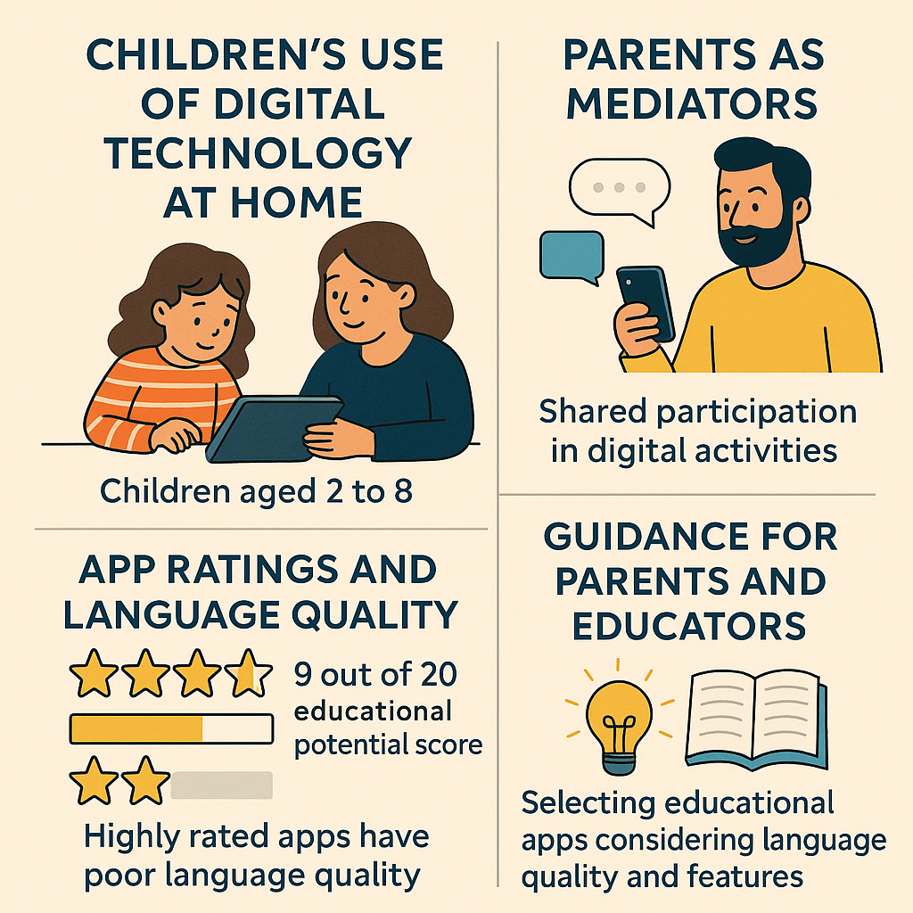
3. Children's Interaction with Digital Technologies (Kotserkova et al., 2022)
Focuses on digital experiences of children aged 2-8.
Highlights parental involvement and app selection criteria.
Emphasizes the educational potential and language quality of apps.

Slide 10
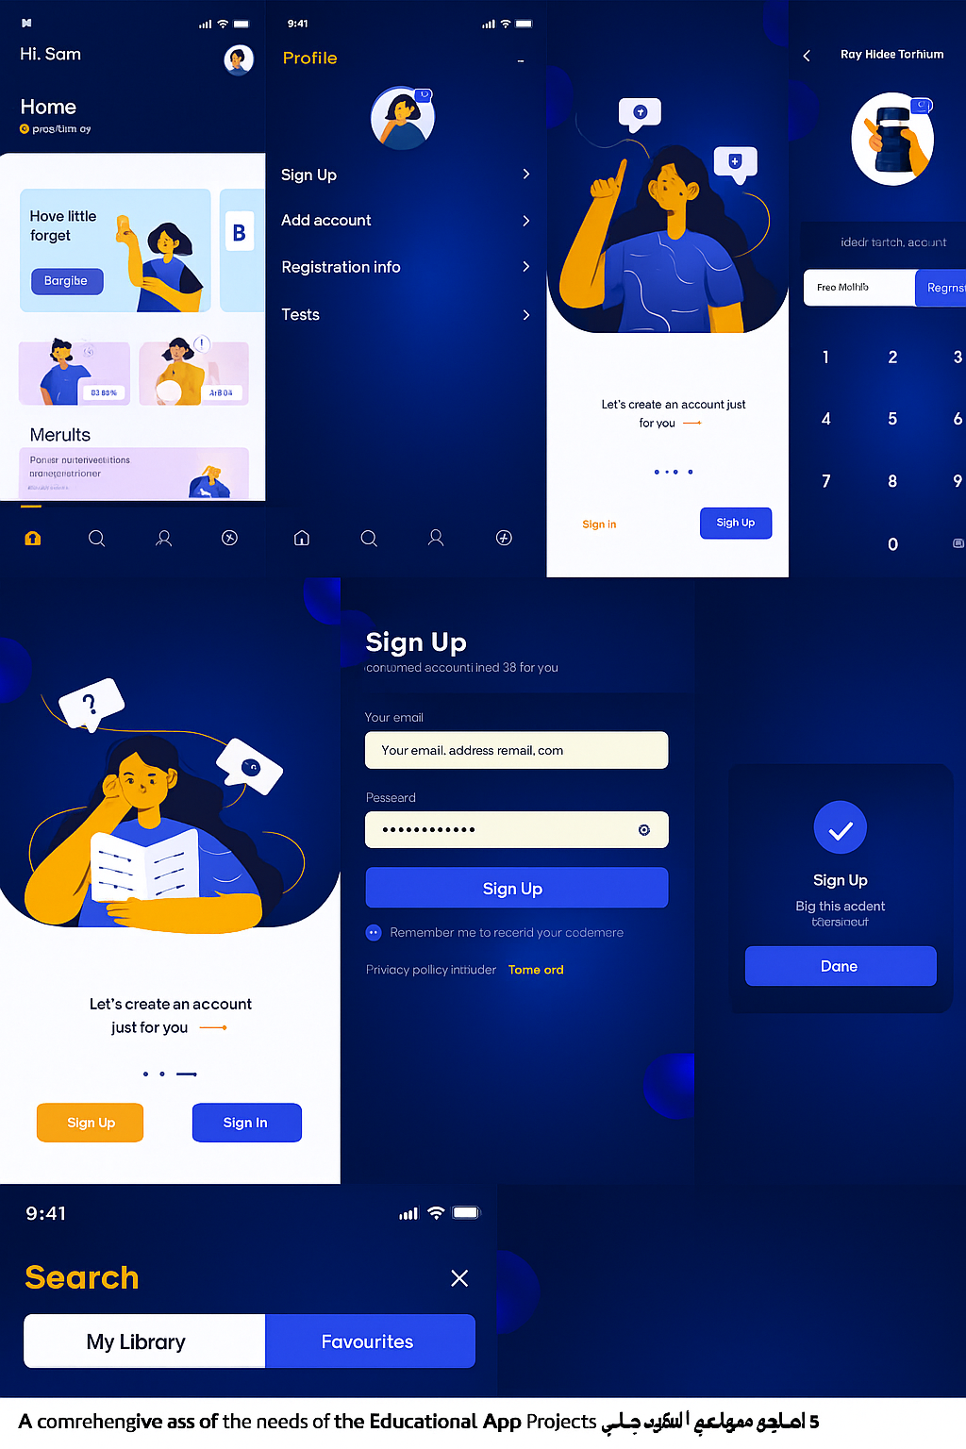
4. Digital Learning Platforms for Children (Sureshwaran et al., 2022)
Developed during the COVID-19 pandemic.
Uses AI technologies like TTS, ML, and NLP for educational video generation.
Enhances engagement, comprehension, and retention.
Reduces production time and costs significantly.

Slide 11
Methodology
Requirement Analysis
Design
Implementation
Testing
Deployment

Slide 12
Requirement Analysis
Developed in response to the community’s need for a safe Arabic educational app for children.
Feedback from parents and teachers highlighted problems in existing apps, such as weak Arabic support and ads.
Focused on creating an easy-to-use, interactive, and ad-free experience.
Improved the app’s design based on feedback from children and educators.

Slide 13
business model
The business model defines how value is delivered highlighting the main components: workflow, target users, key partners, revenue sources, and distribution channels.

Slide 14
business model
The four most important elements of the business model:
Value Proposition: Interactive and safe educational content in Arabic.
Customer Segments: Children aged 4–10, parents, and teachers.
Channels: Google Play Store, partnerships with schools and kindergartens.
Revenue Streams: Paid subscriptions and a free version with safe ads.

Slide 15
Design
Scalability and Future Development: The system is built with a flexible design that allows new games or educational content to be added easily at any time in the future, without the need to rebuild the entire application.
Child-Friendly User Interface: Large, clear interfaces with bright colors and child-appropriate buttons ensure easy navigation and interaction, even for younger users.

Slide 16
Design
Advanced Security and Data Protection: Firebase Authentication is used for children over the age of 6 to secure accounts, with all data safely stored using Firestore.
Full Arabic Language Support: All screens and content are fully localized in Arabic to suit Arab children, with future plans to support additional languages.

Slide 17
Design
Why space theme?
The space theme was chosen because it sparks children's imagination and encourages them to explore and learn in a fun, colorful environment filled with engaging elements like planets and stars. Space is also non-traditional, offering a sense of adventure and challenge that increases the child's interaction with the app and enhances their desire to learn through play.

Slide 18
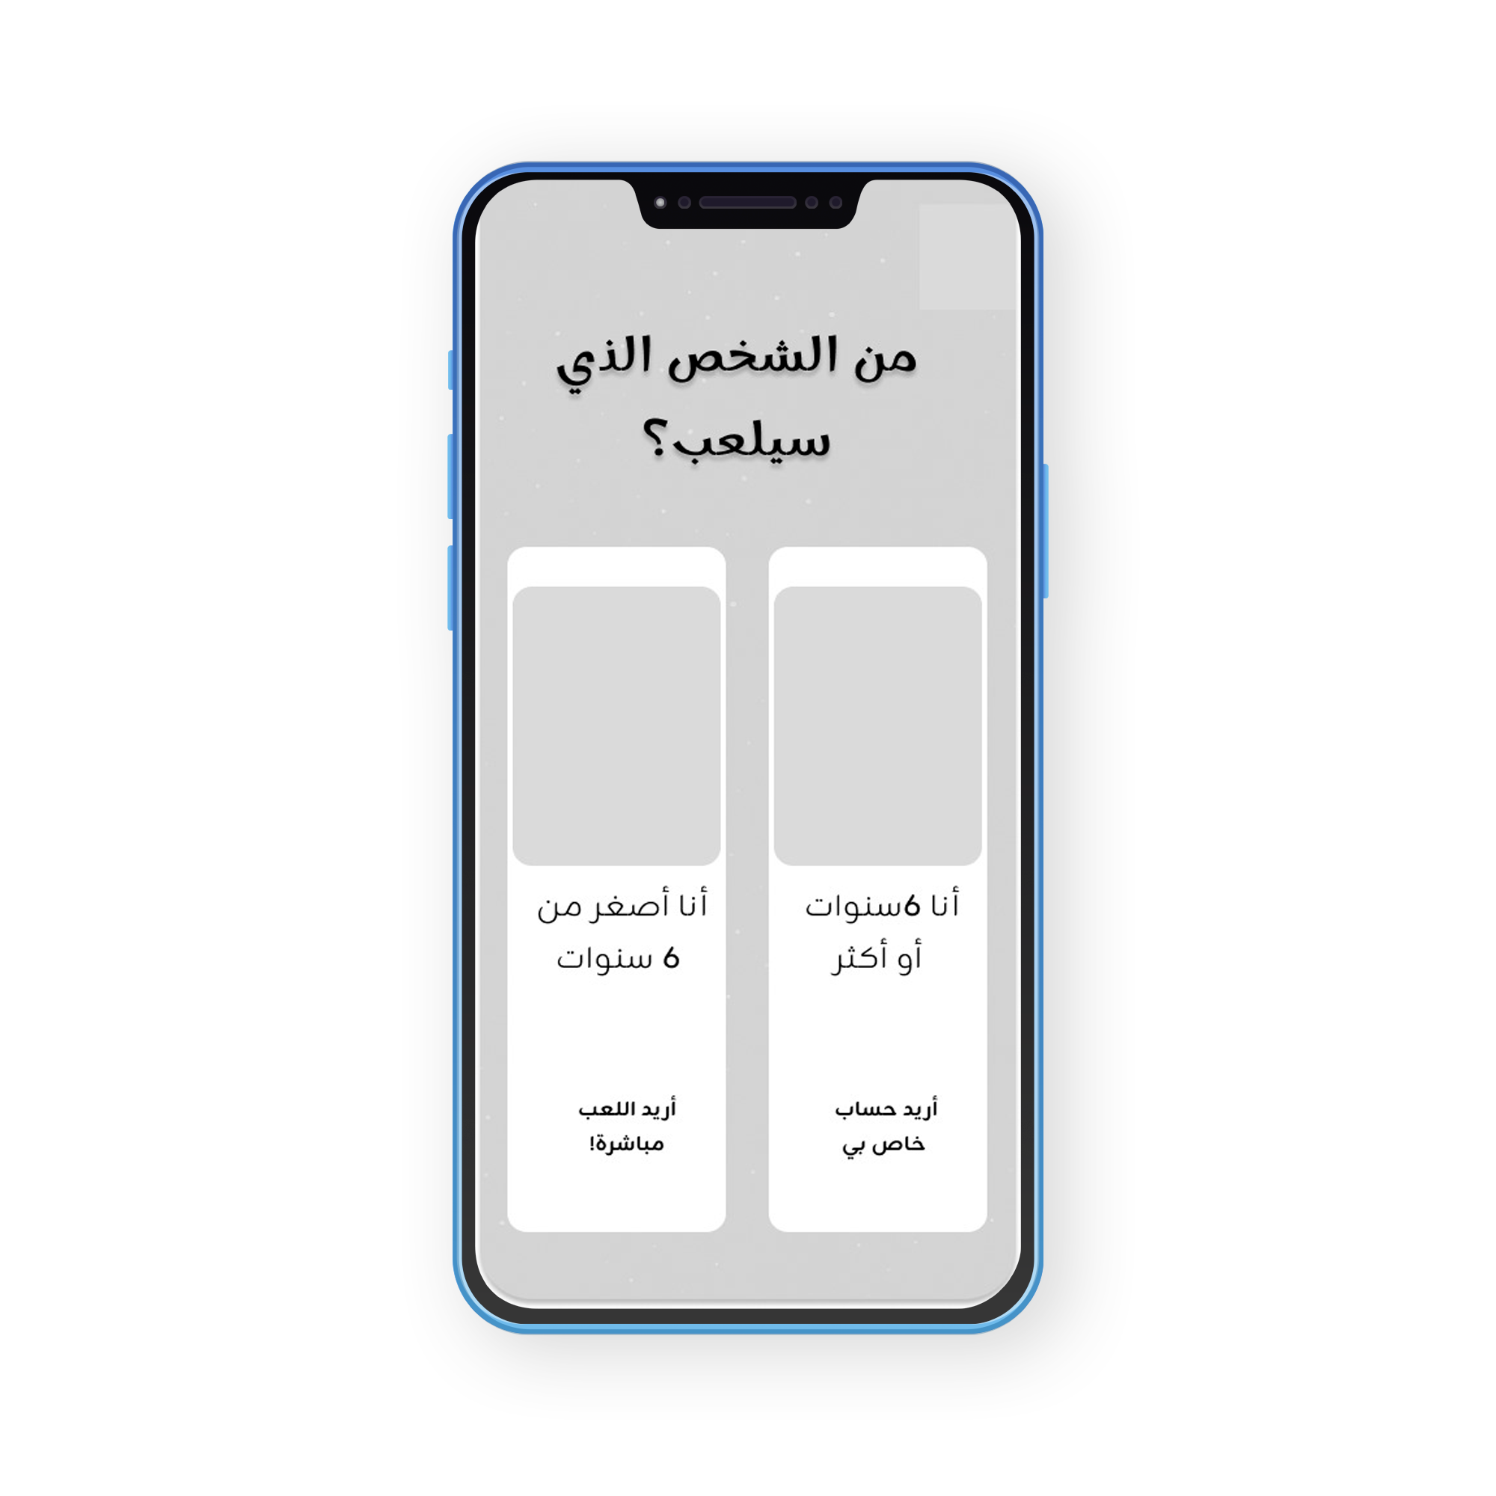
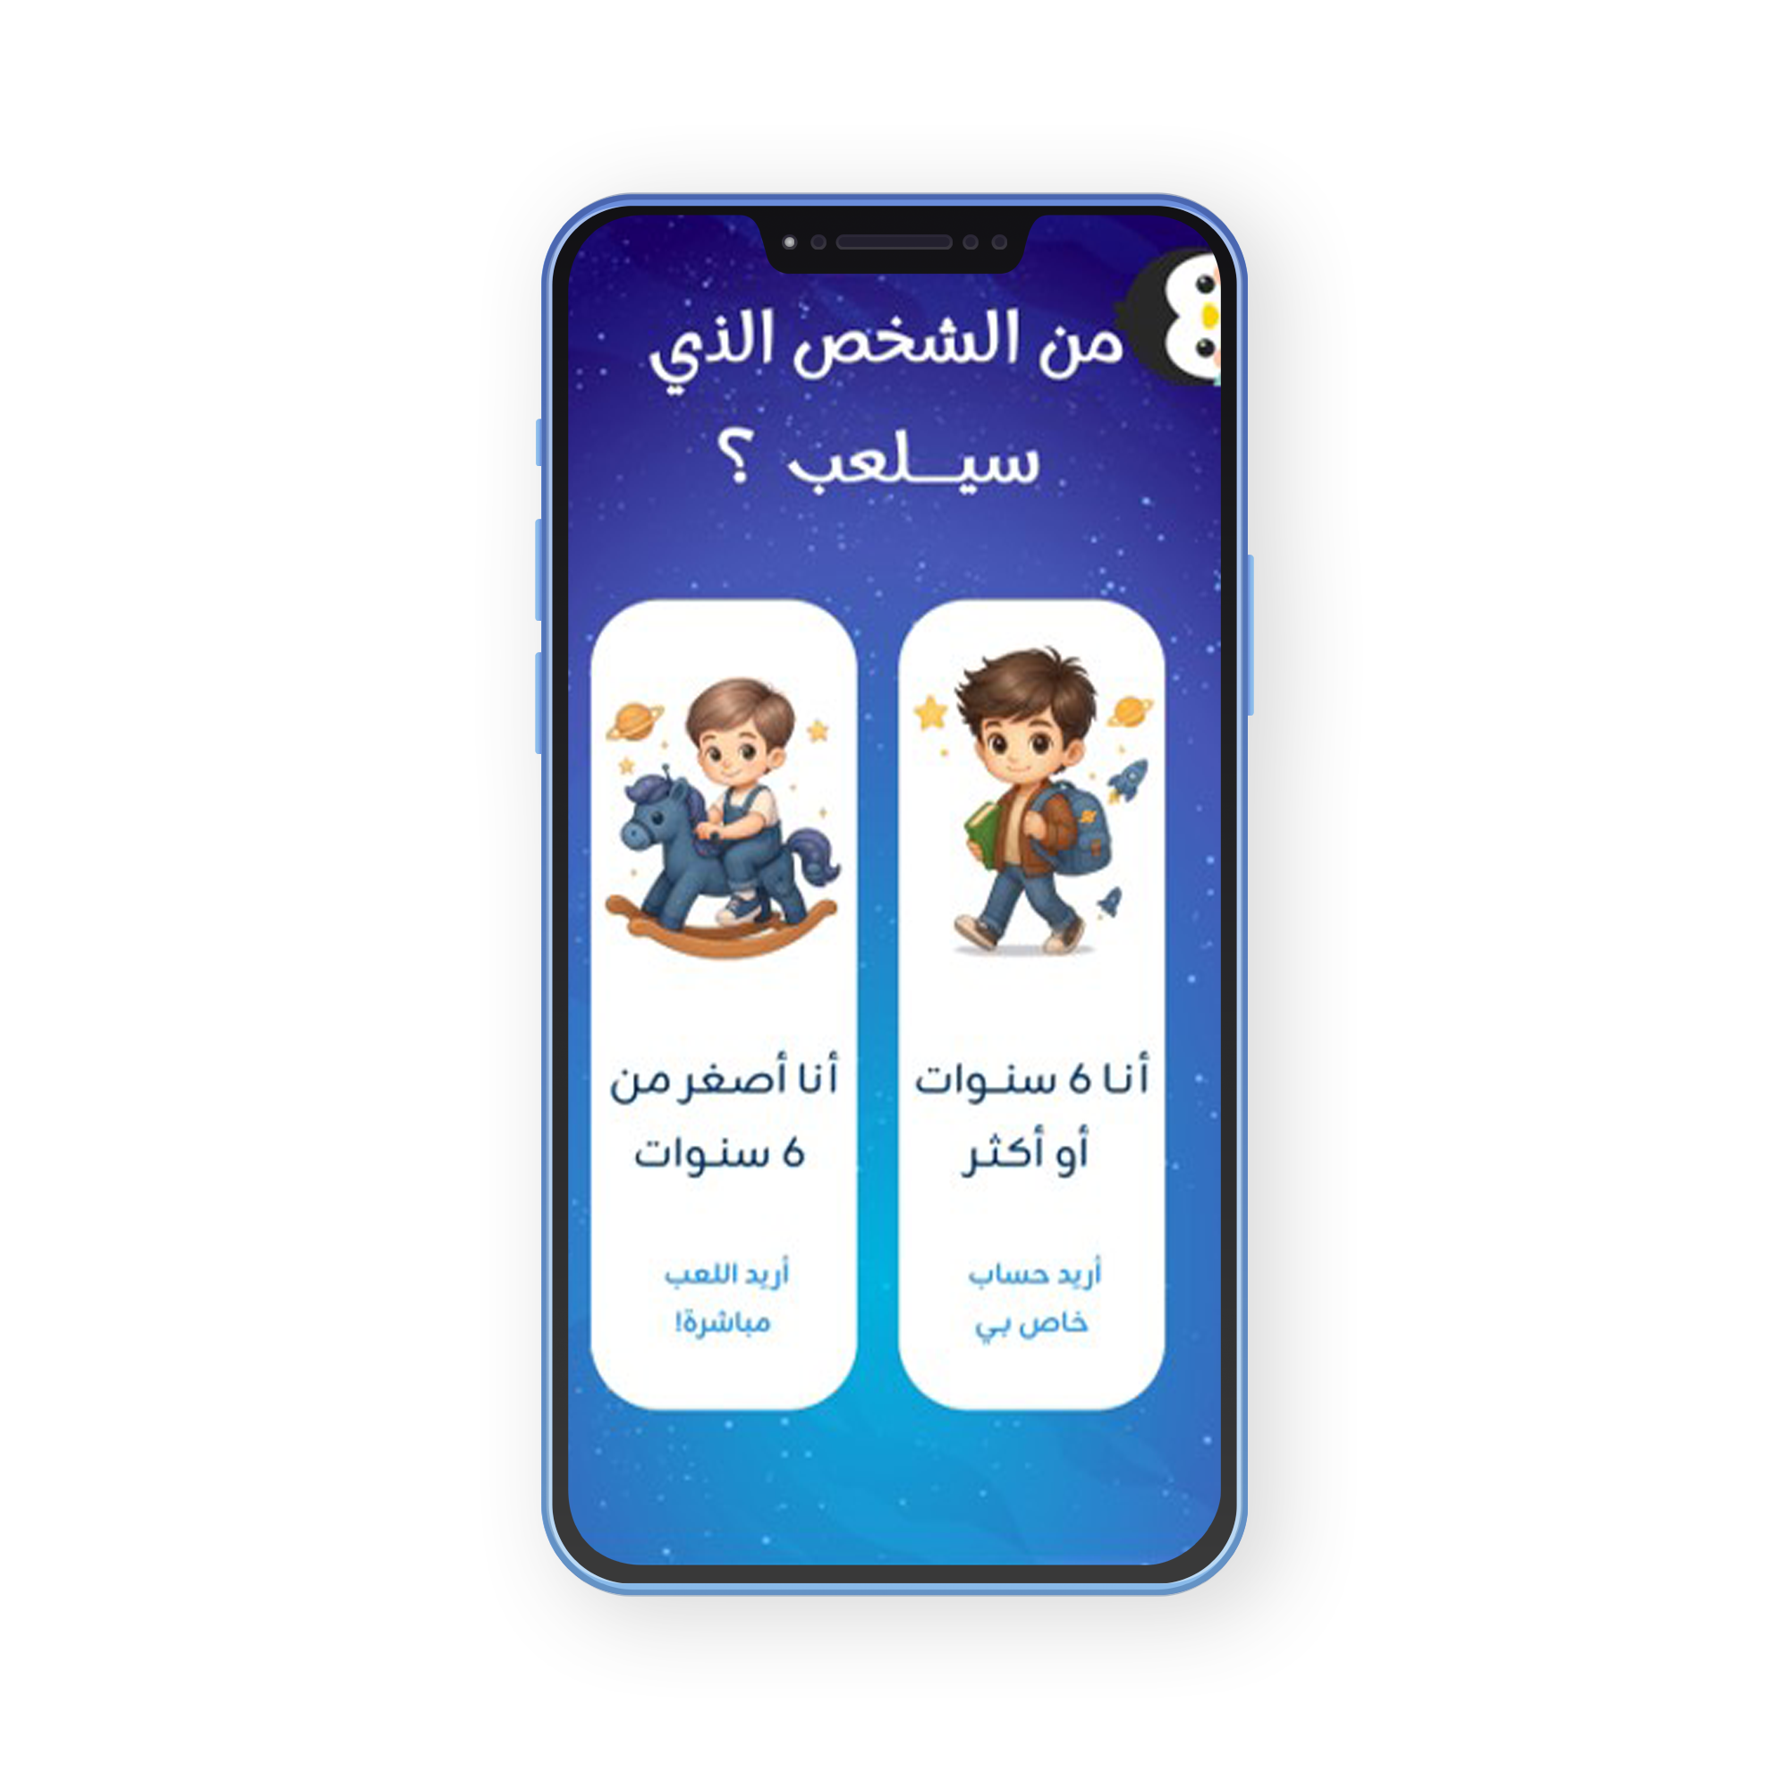
Simple wireframe for child age screen
Final colorful design,
engaging and child-friendly

Slide 19
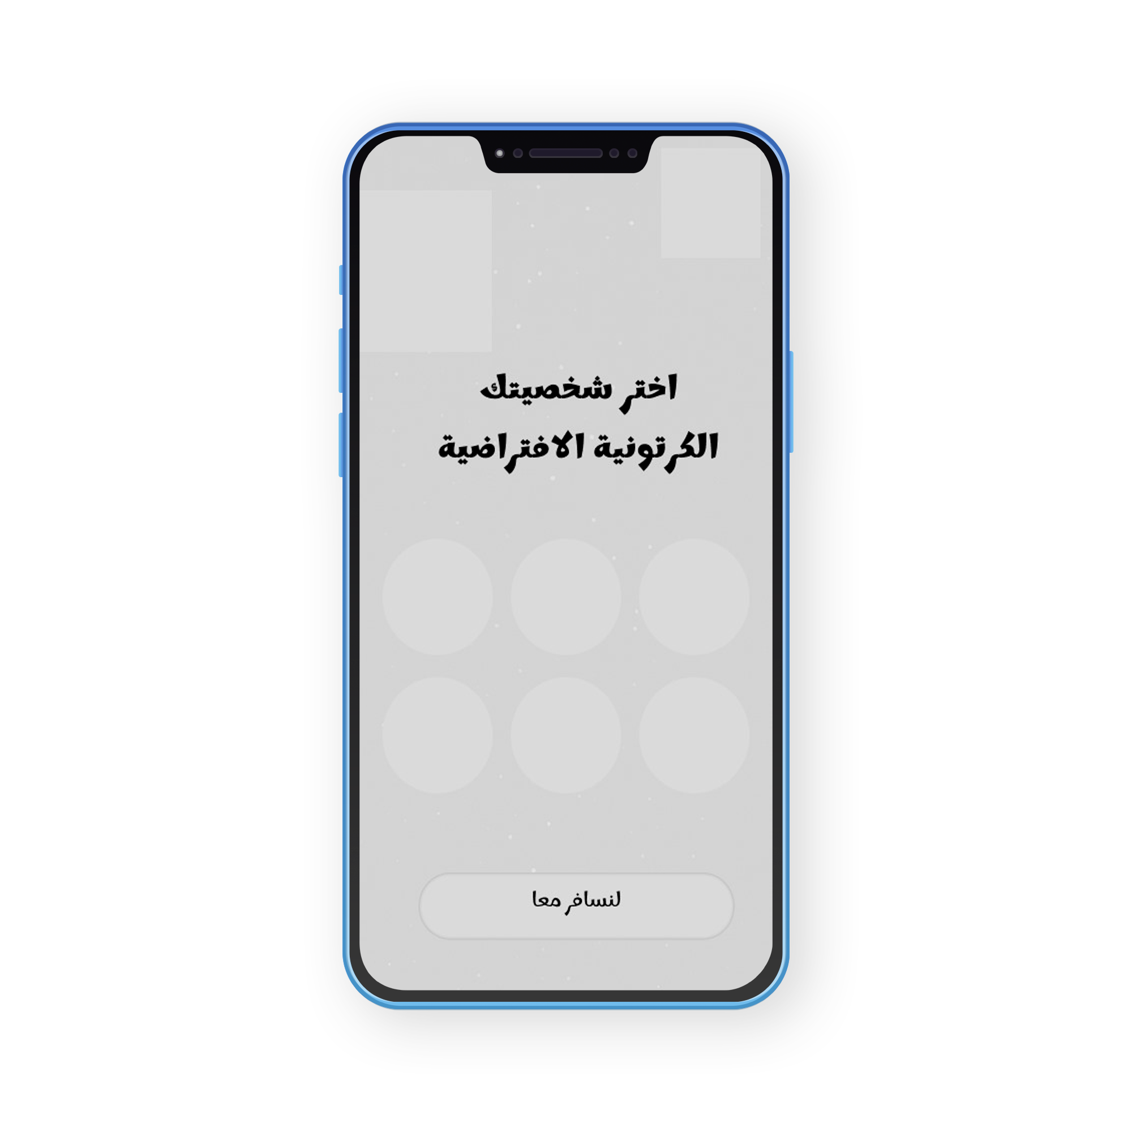
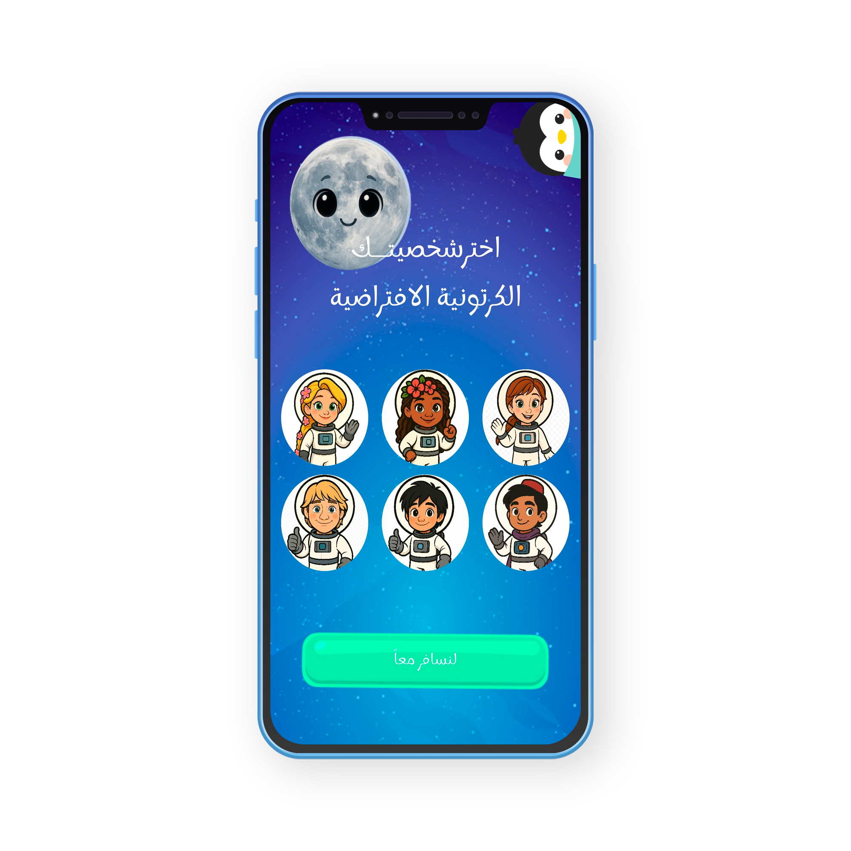
Simple character selection wireframe
Final design with colorful, fun characters for kids

Slide 20
Implementation
Building the main interfaces using Kotlin and designing them with XML.
Developing interactive games using C# and the Unity engine.
Integrating Lottie animations and sound effects to attract children.
Using Firebase Authentication for secure accounts.
Storing the child's data and progress in the cloud via Firestore.

Slide 21
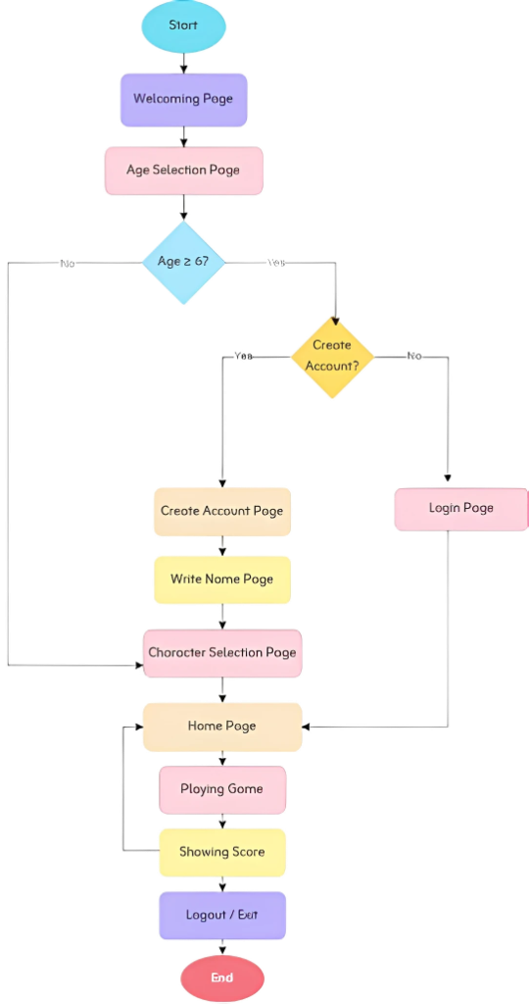
Implementation
This flowchart illustrates the main steps of the app:
The app starts with a welcome screen and asks for the child’s age.

Slide 22
Implementation
If the child is 6 years or older: • Create an account • Enter the name • Choose a character • Go to the home page
If the child is younger than 6: • Choose a character • Go to the home page
Then, all children can: • Play educational games • View their score • Log out or exit the app

Slide 23
Testing
✅ Unit Testing:
Tested each screen and function separately.
🔗 Integration Testing:
Checked data flow and screen connections (e.g., games with Firestore).
🧪 System Testing:
Simulated full user journeys (signup → play → save progress).
🎨 UI Testing:
Ensured interface clarity and easy navigation.

Slide 24
Deployment
The app will be launched soon on Google Play for Android devices.
A marketing strategy and clear app description will highlight its educational value for parents and teachers.

Slide 25
User Interfaces

Slide 26
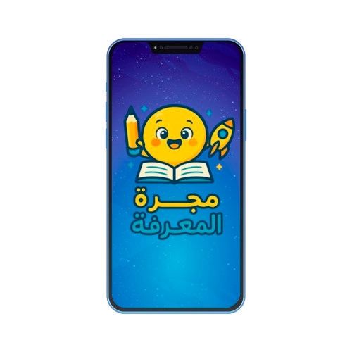
splash screen

Slide 27
Child Age
screen

Slide 28
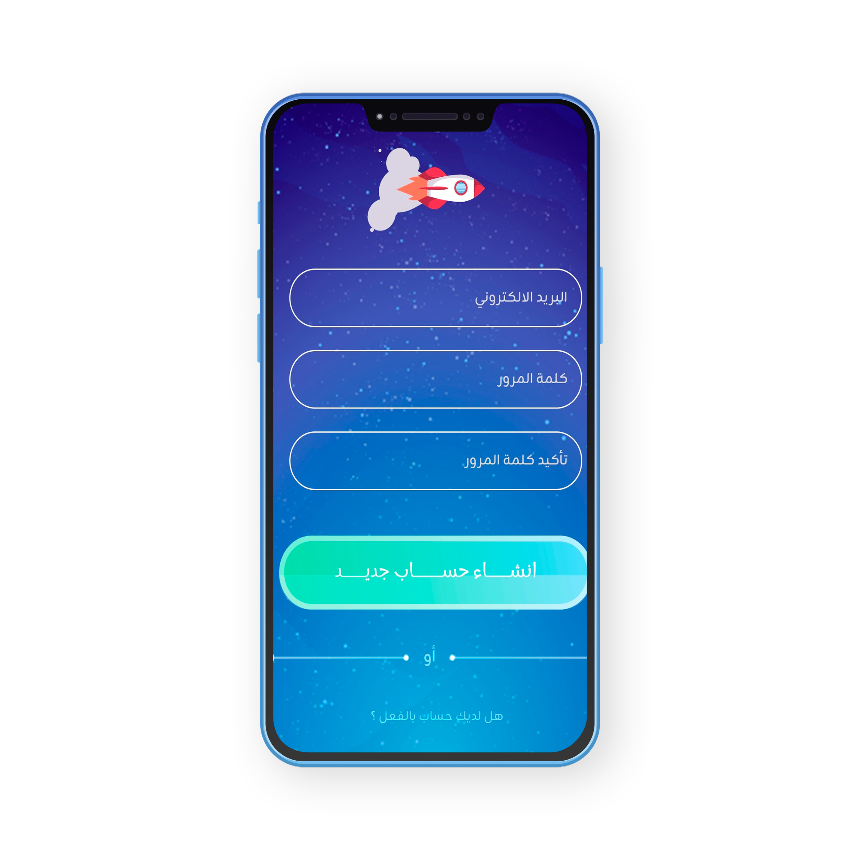
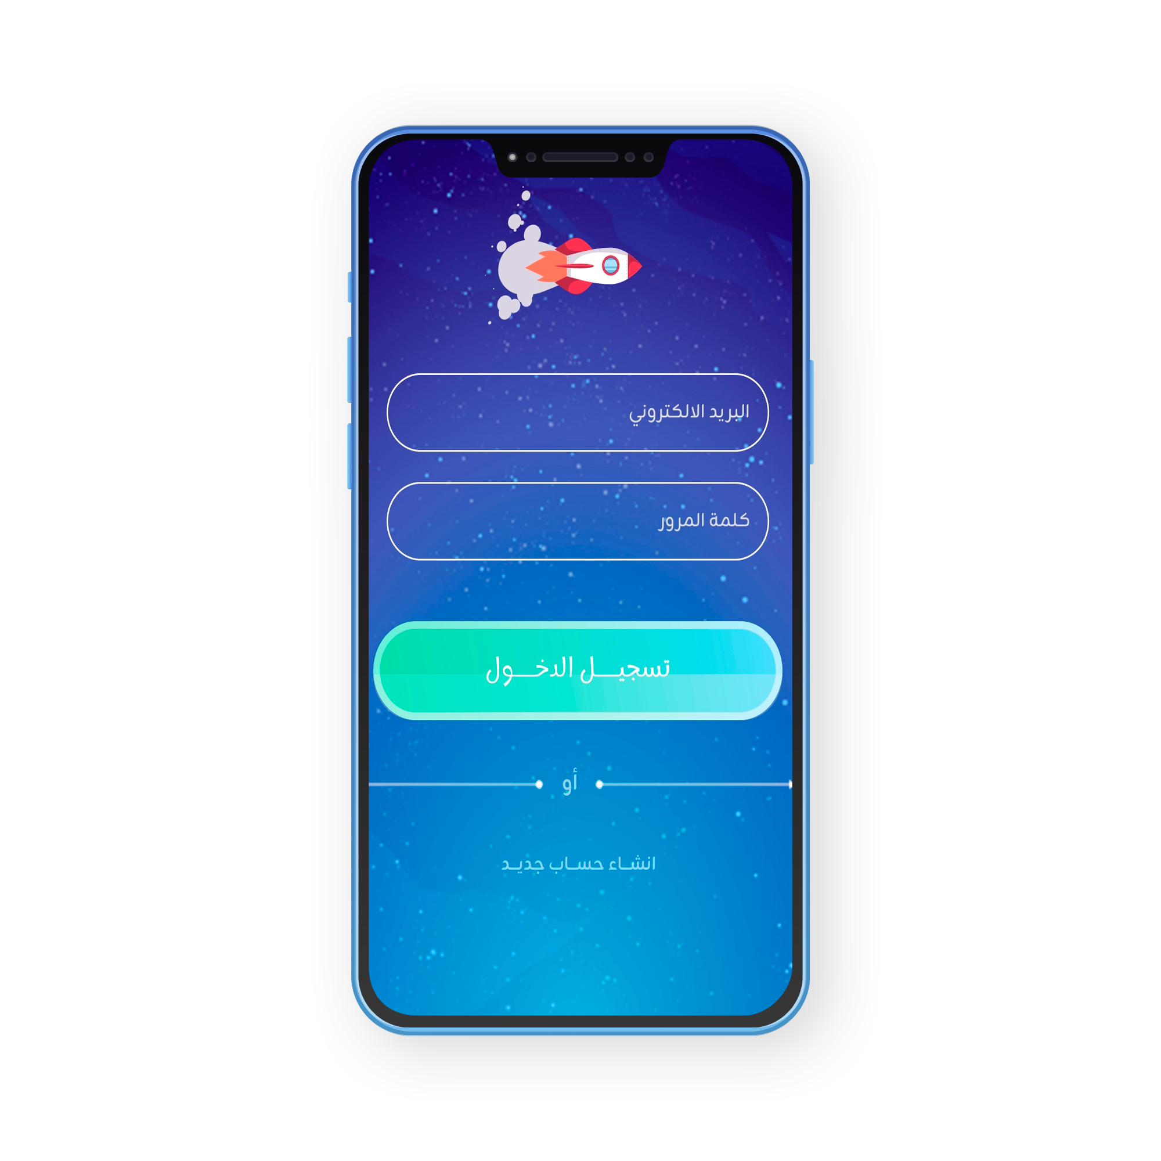
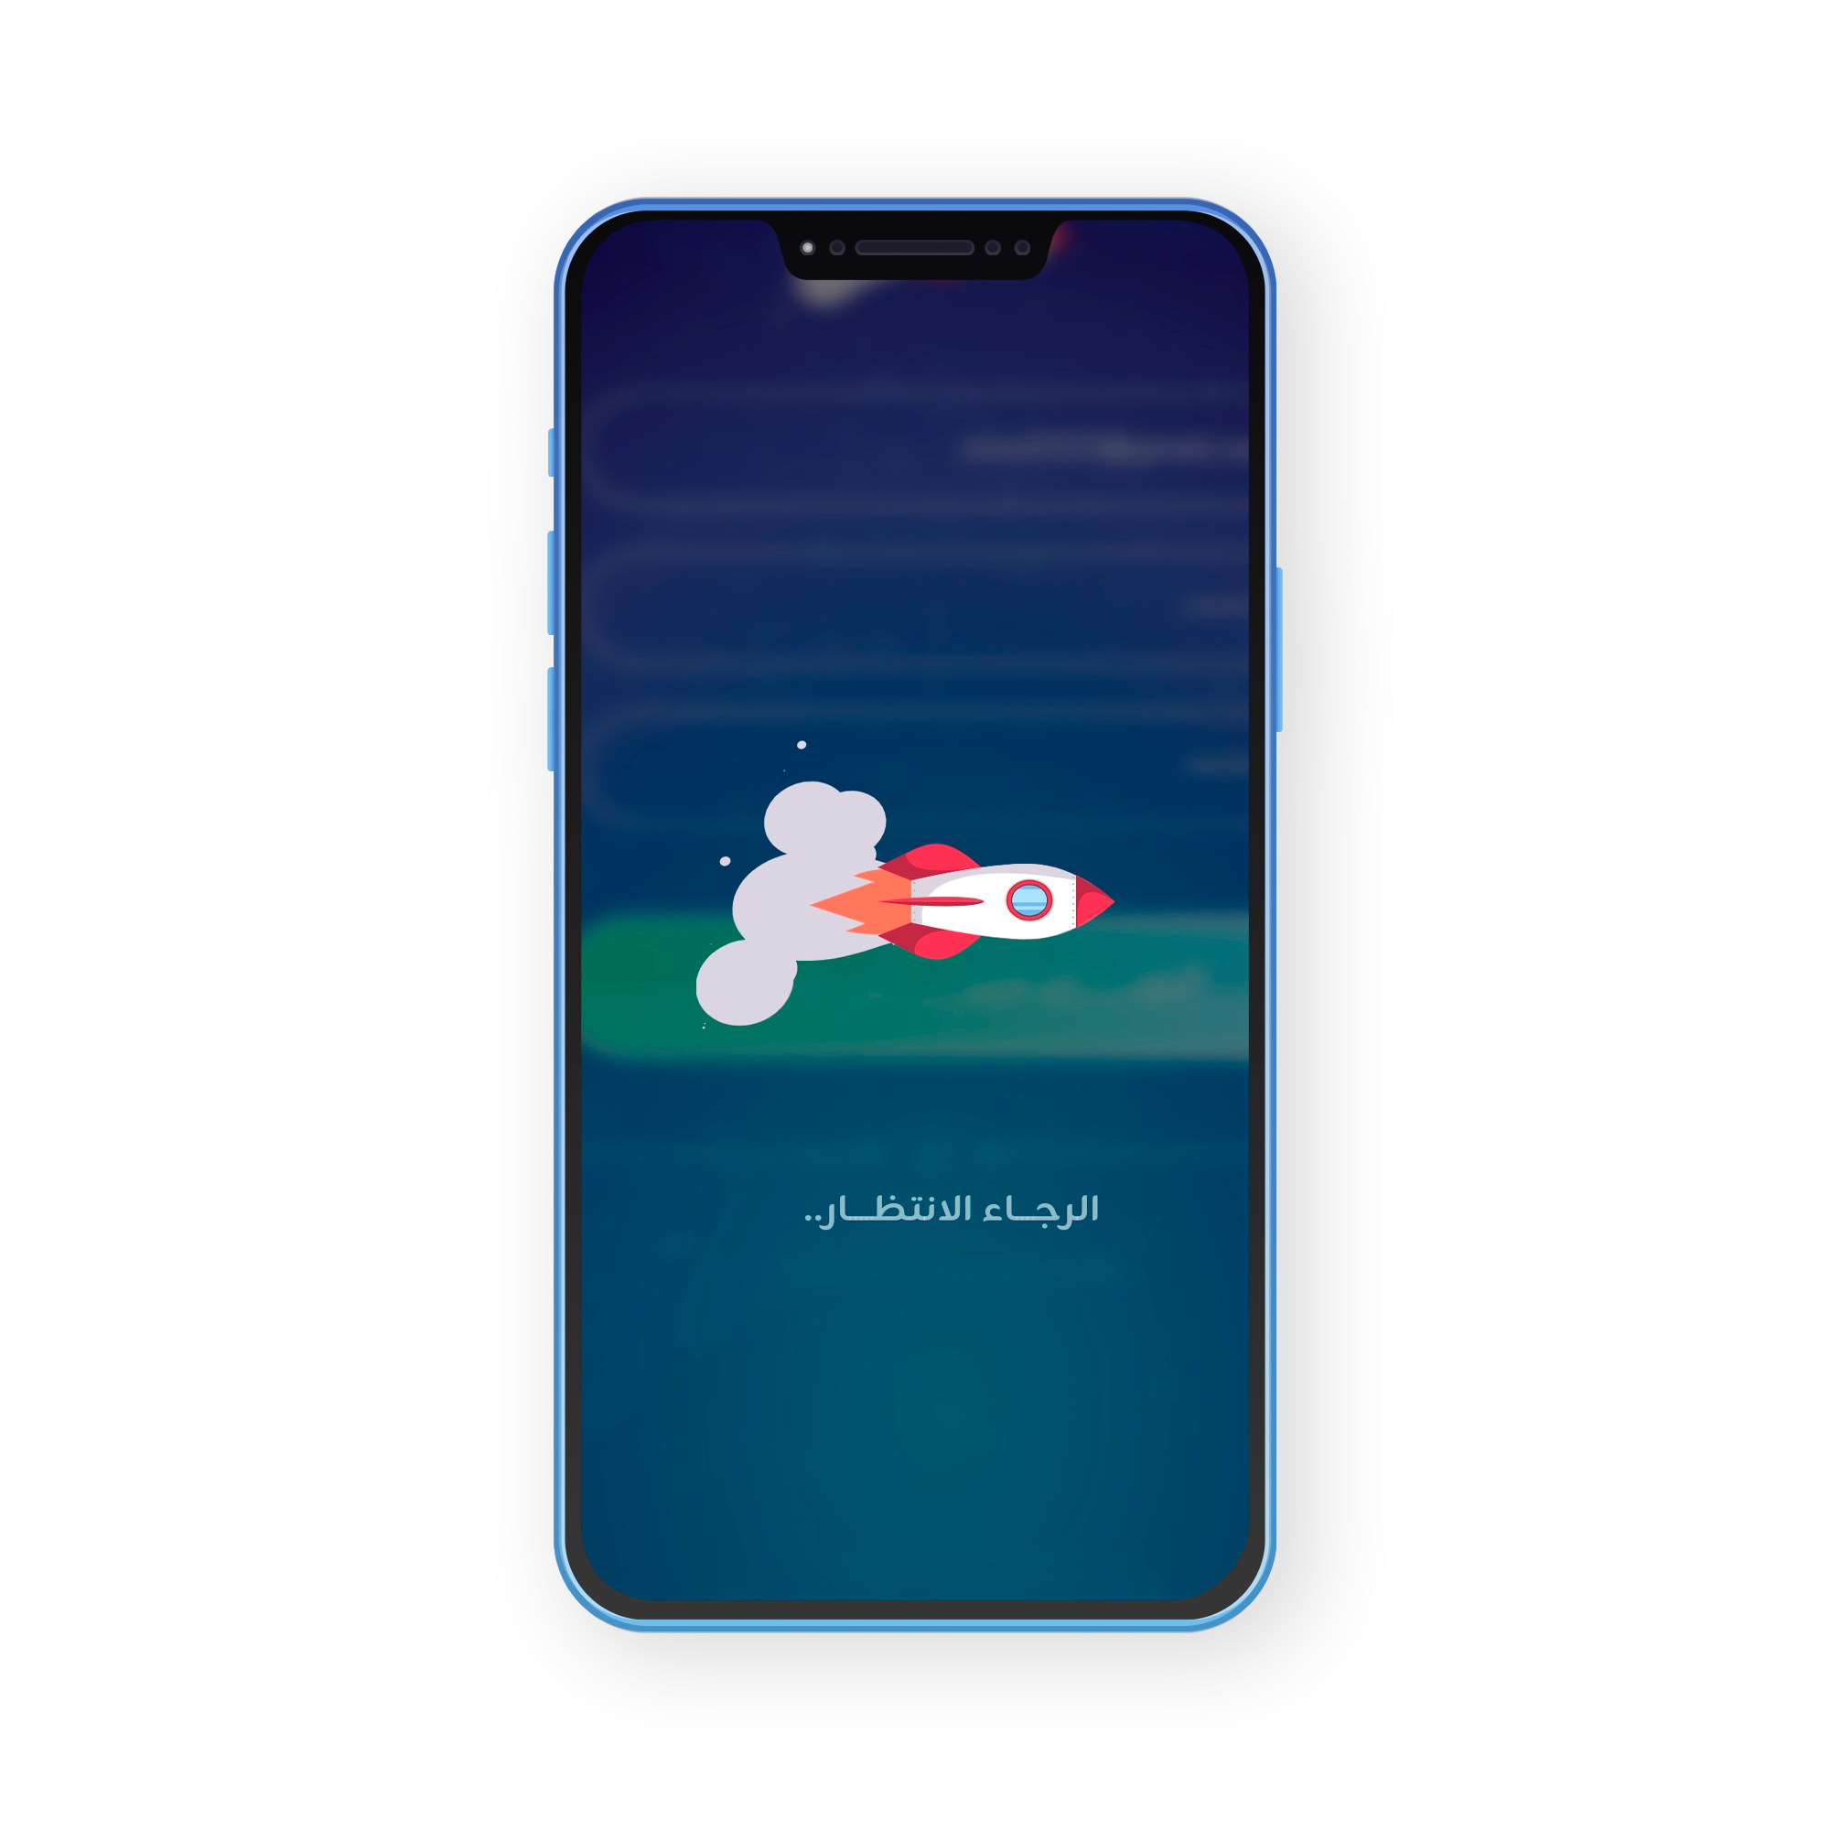
Loading Bar
Sign In Screen
Create Account Screen

Slide 29
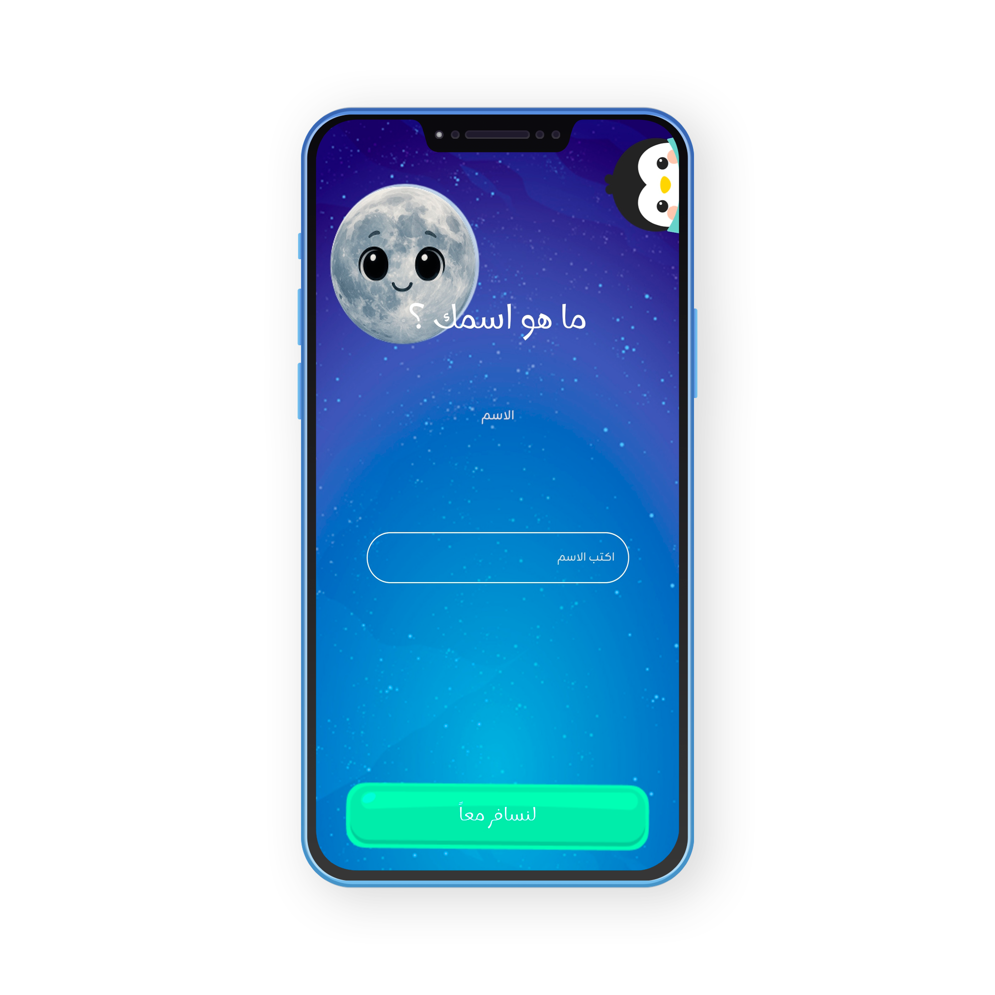
Select Character Screen
Write Name Screen

Slide 30
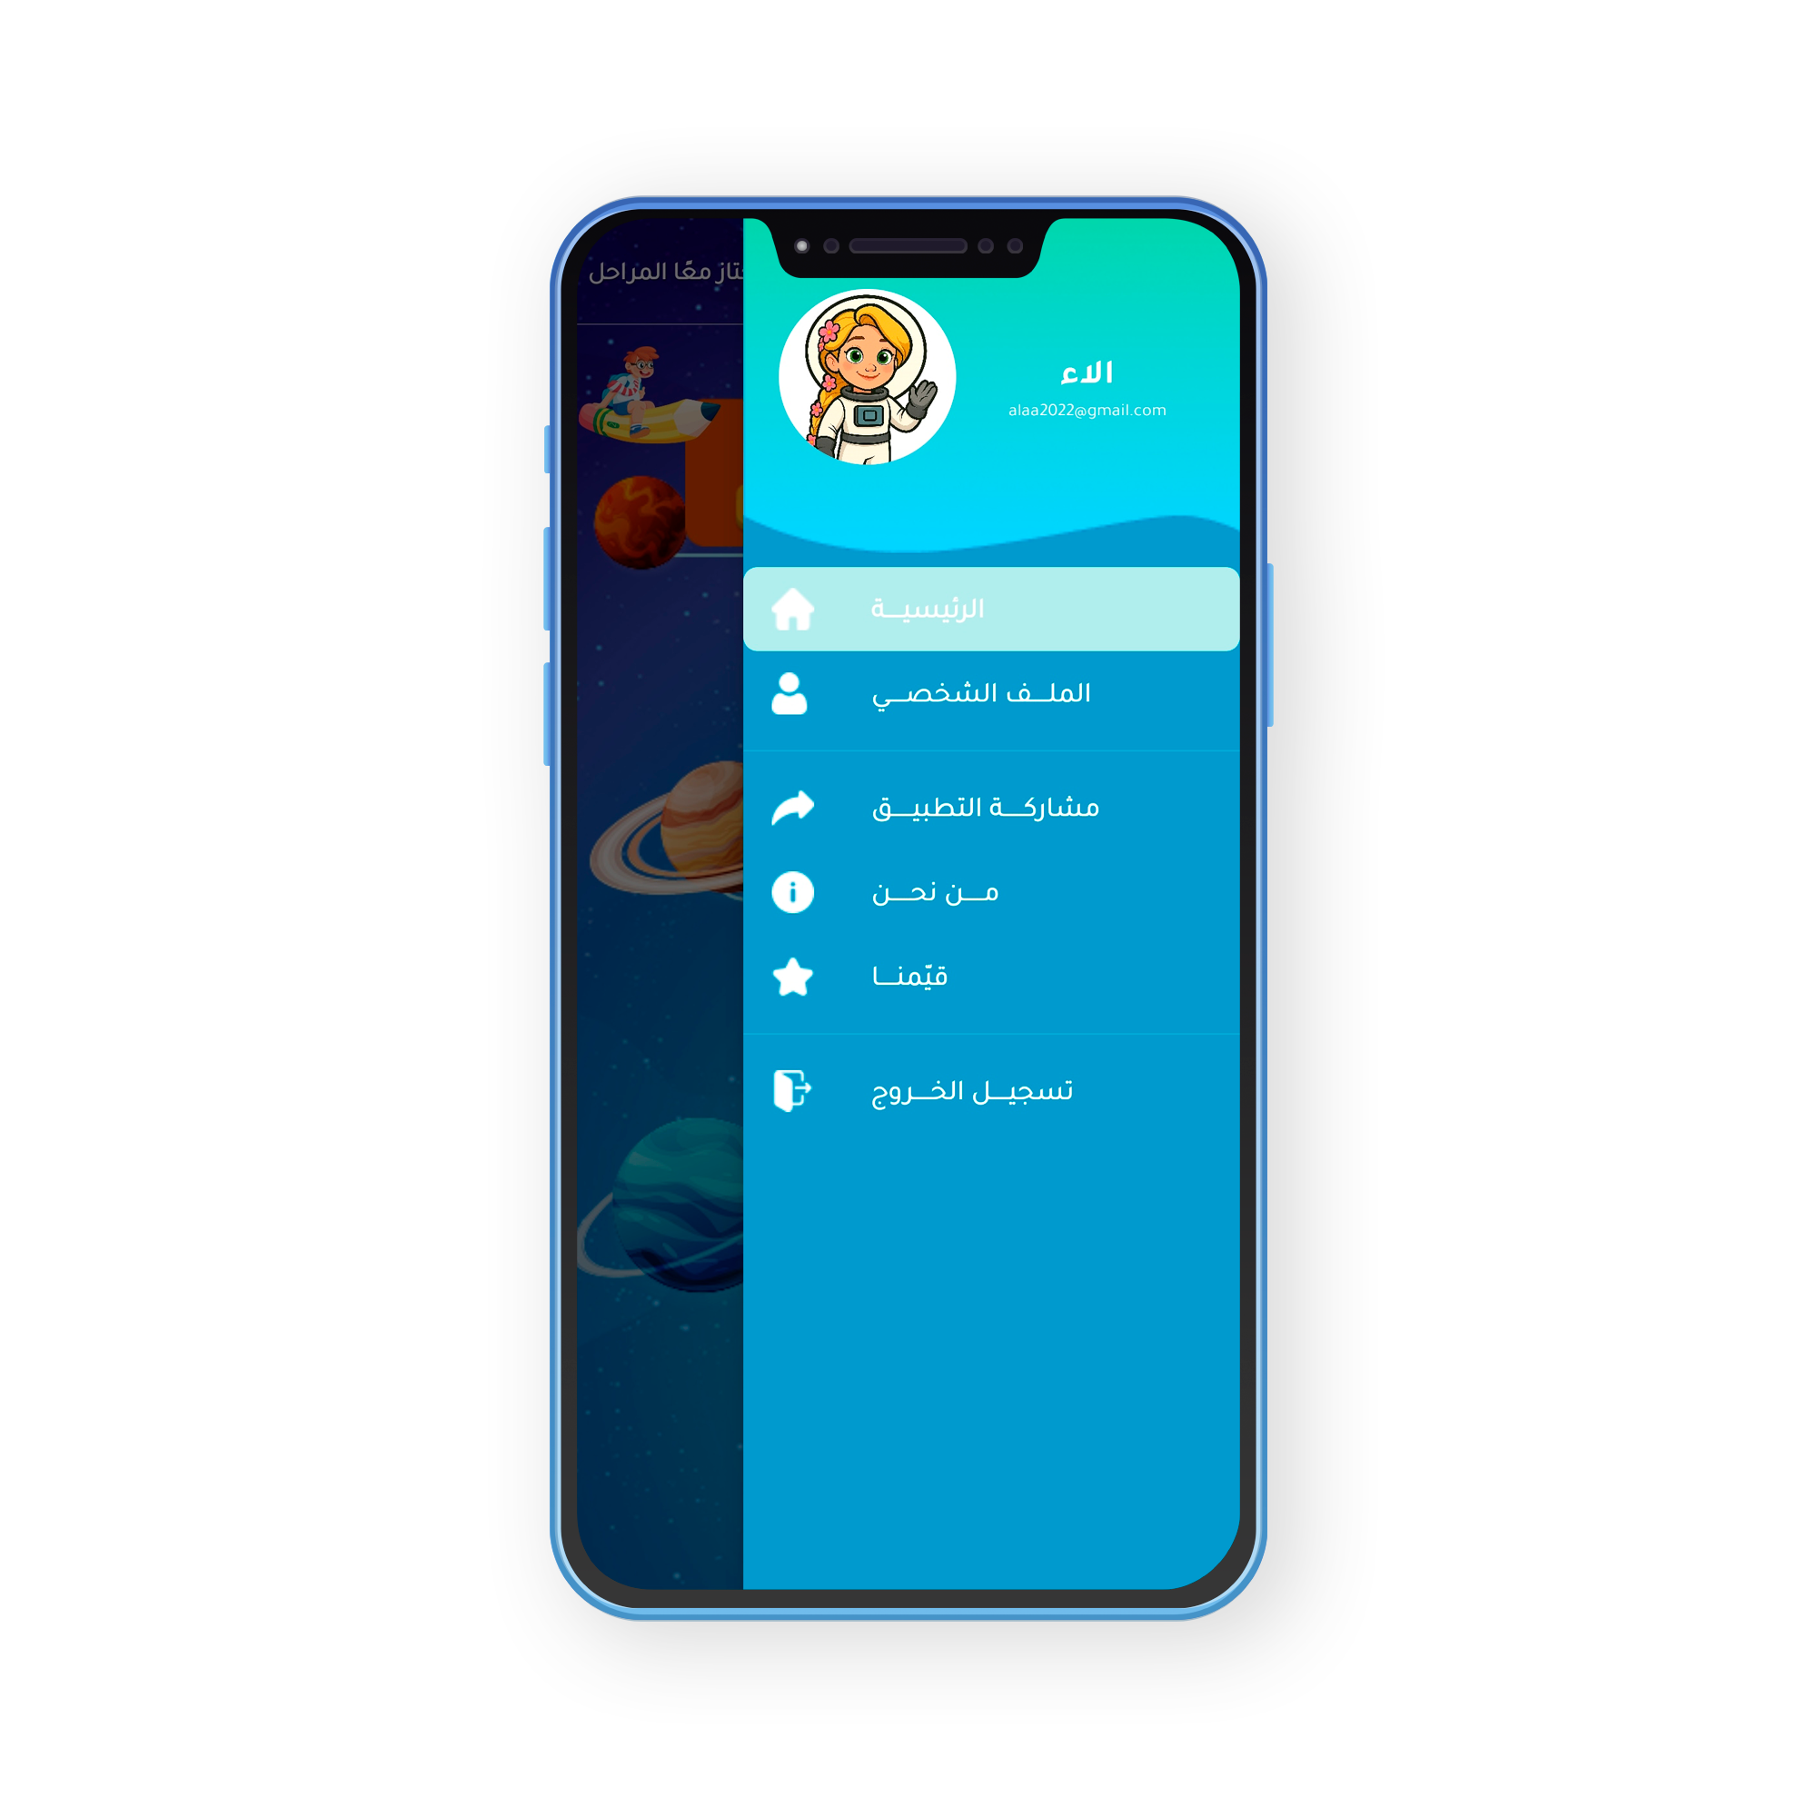
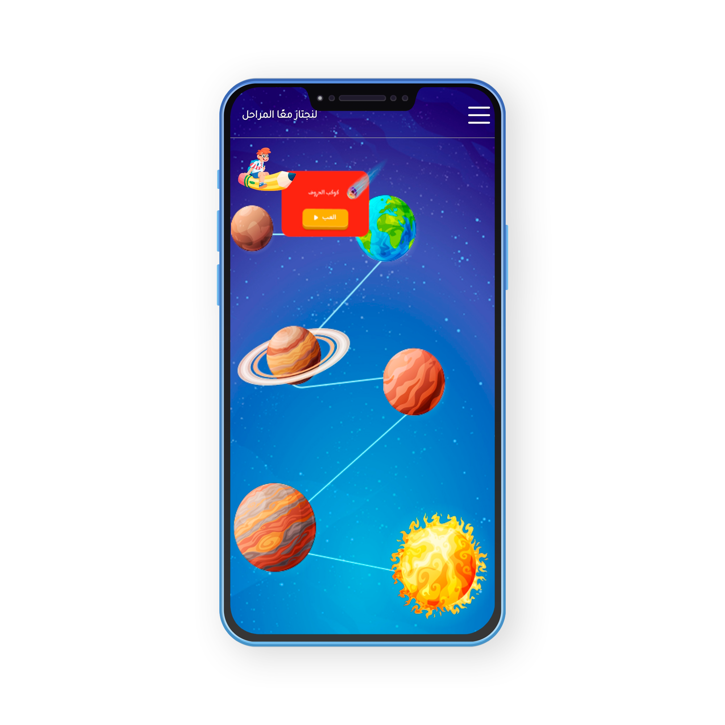
Home Screen
Drawer

Slide 31
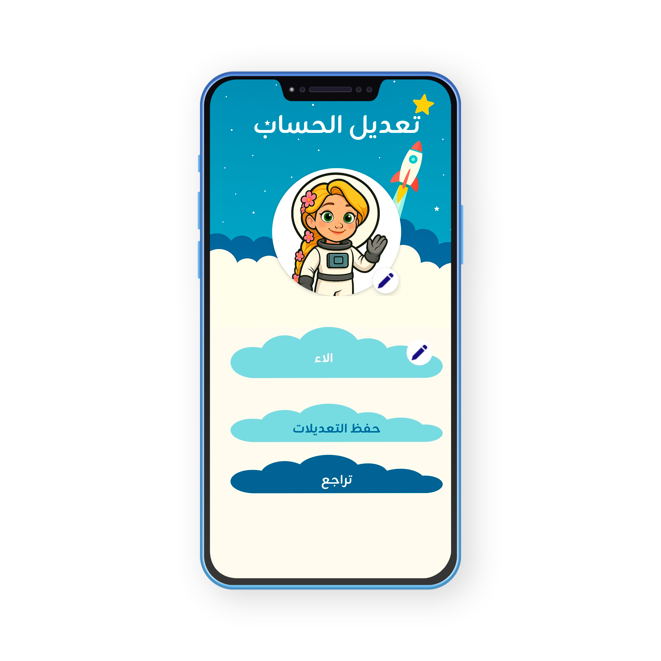
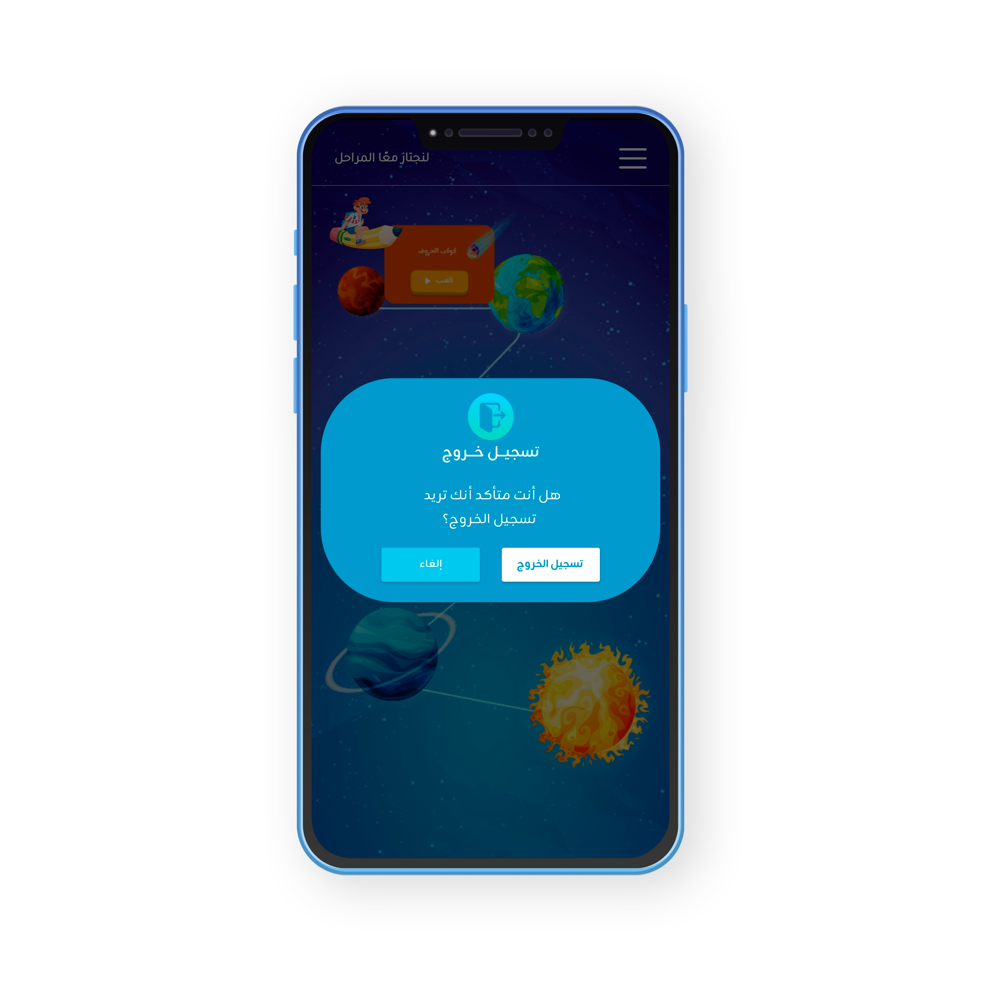
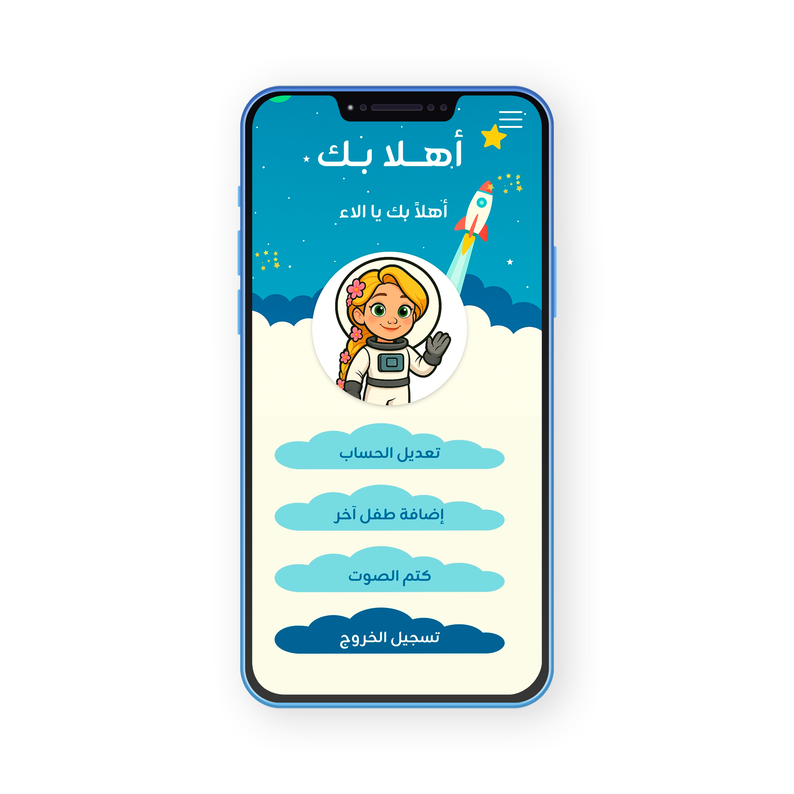
Edit Screen
Logout Screen
Profile Screen

Slide 32
Games

Slide 33
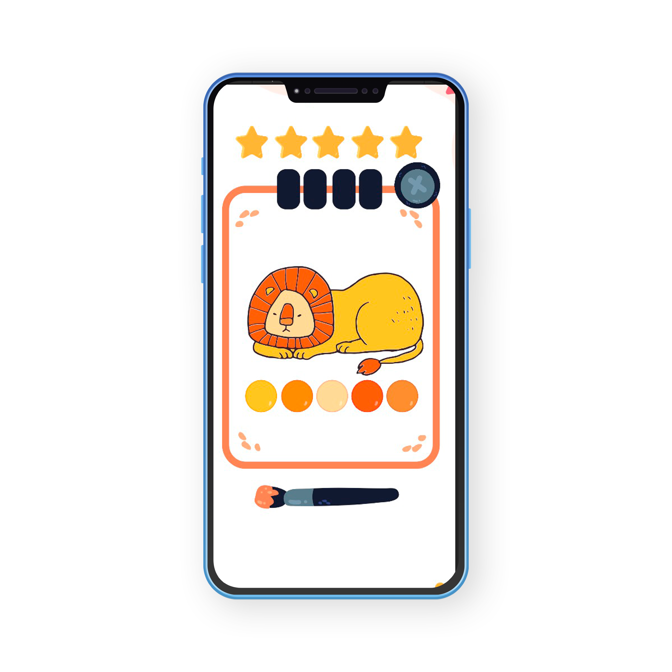
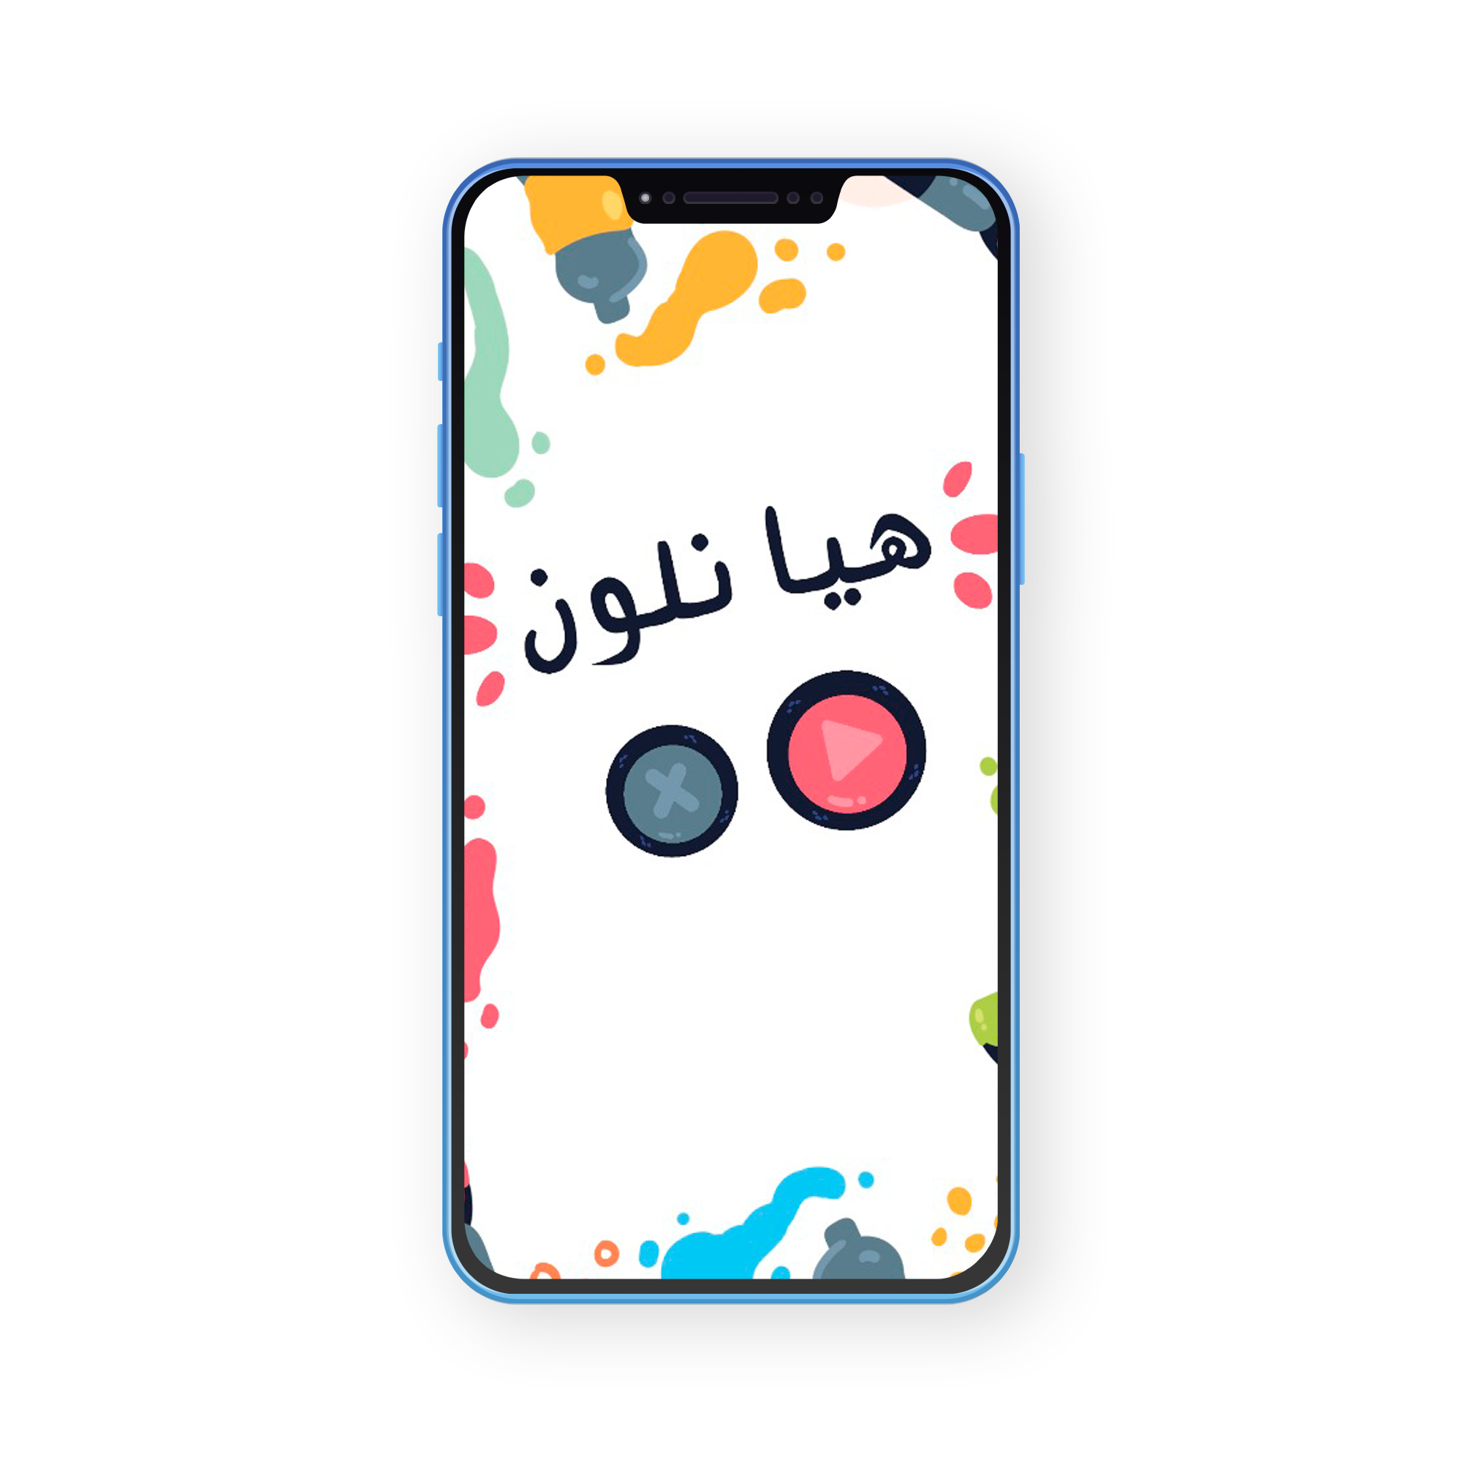
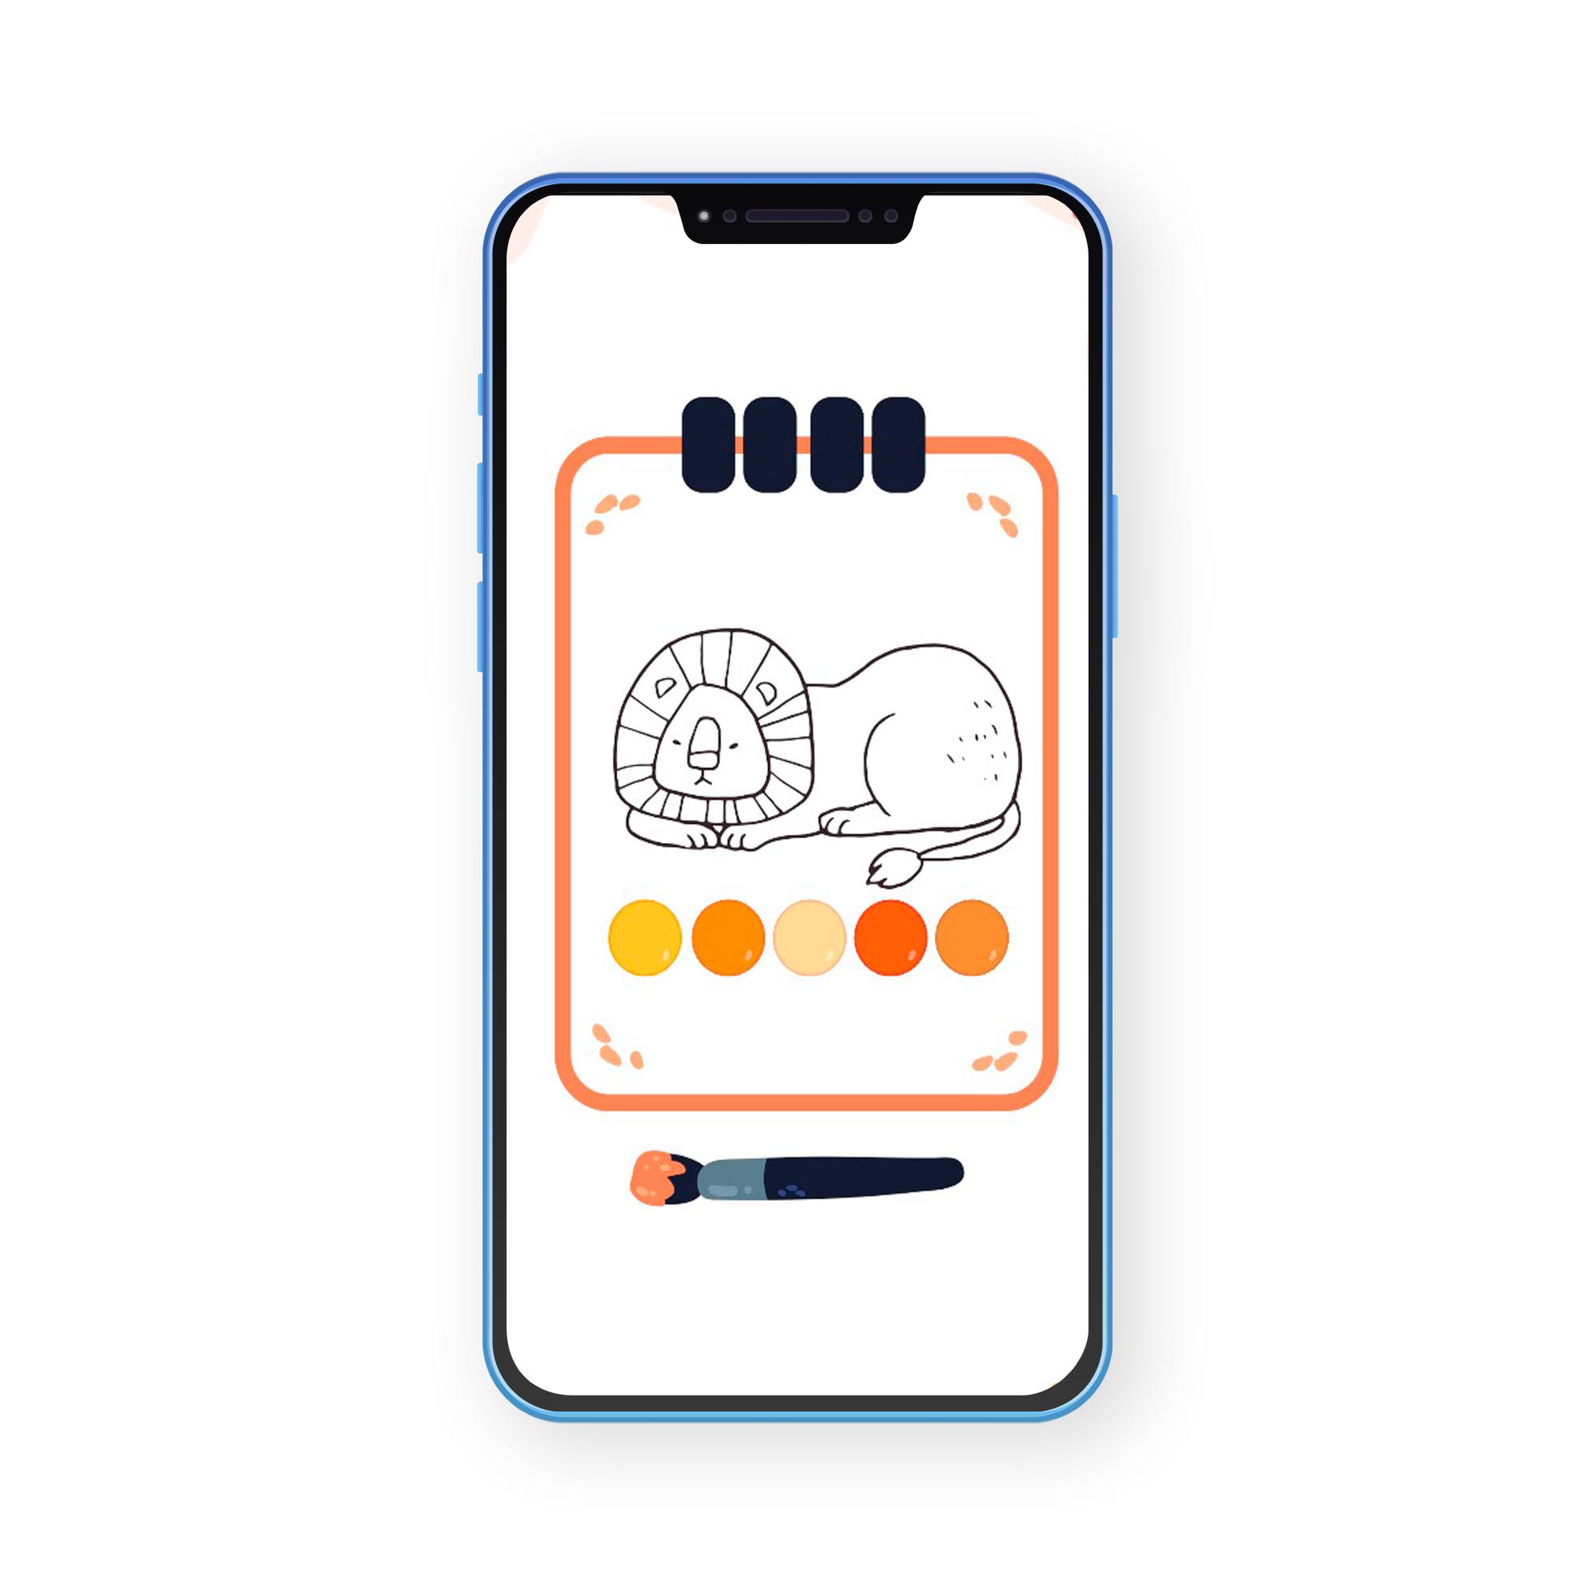
Coloring Game

Slide 34
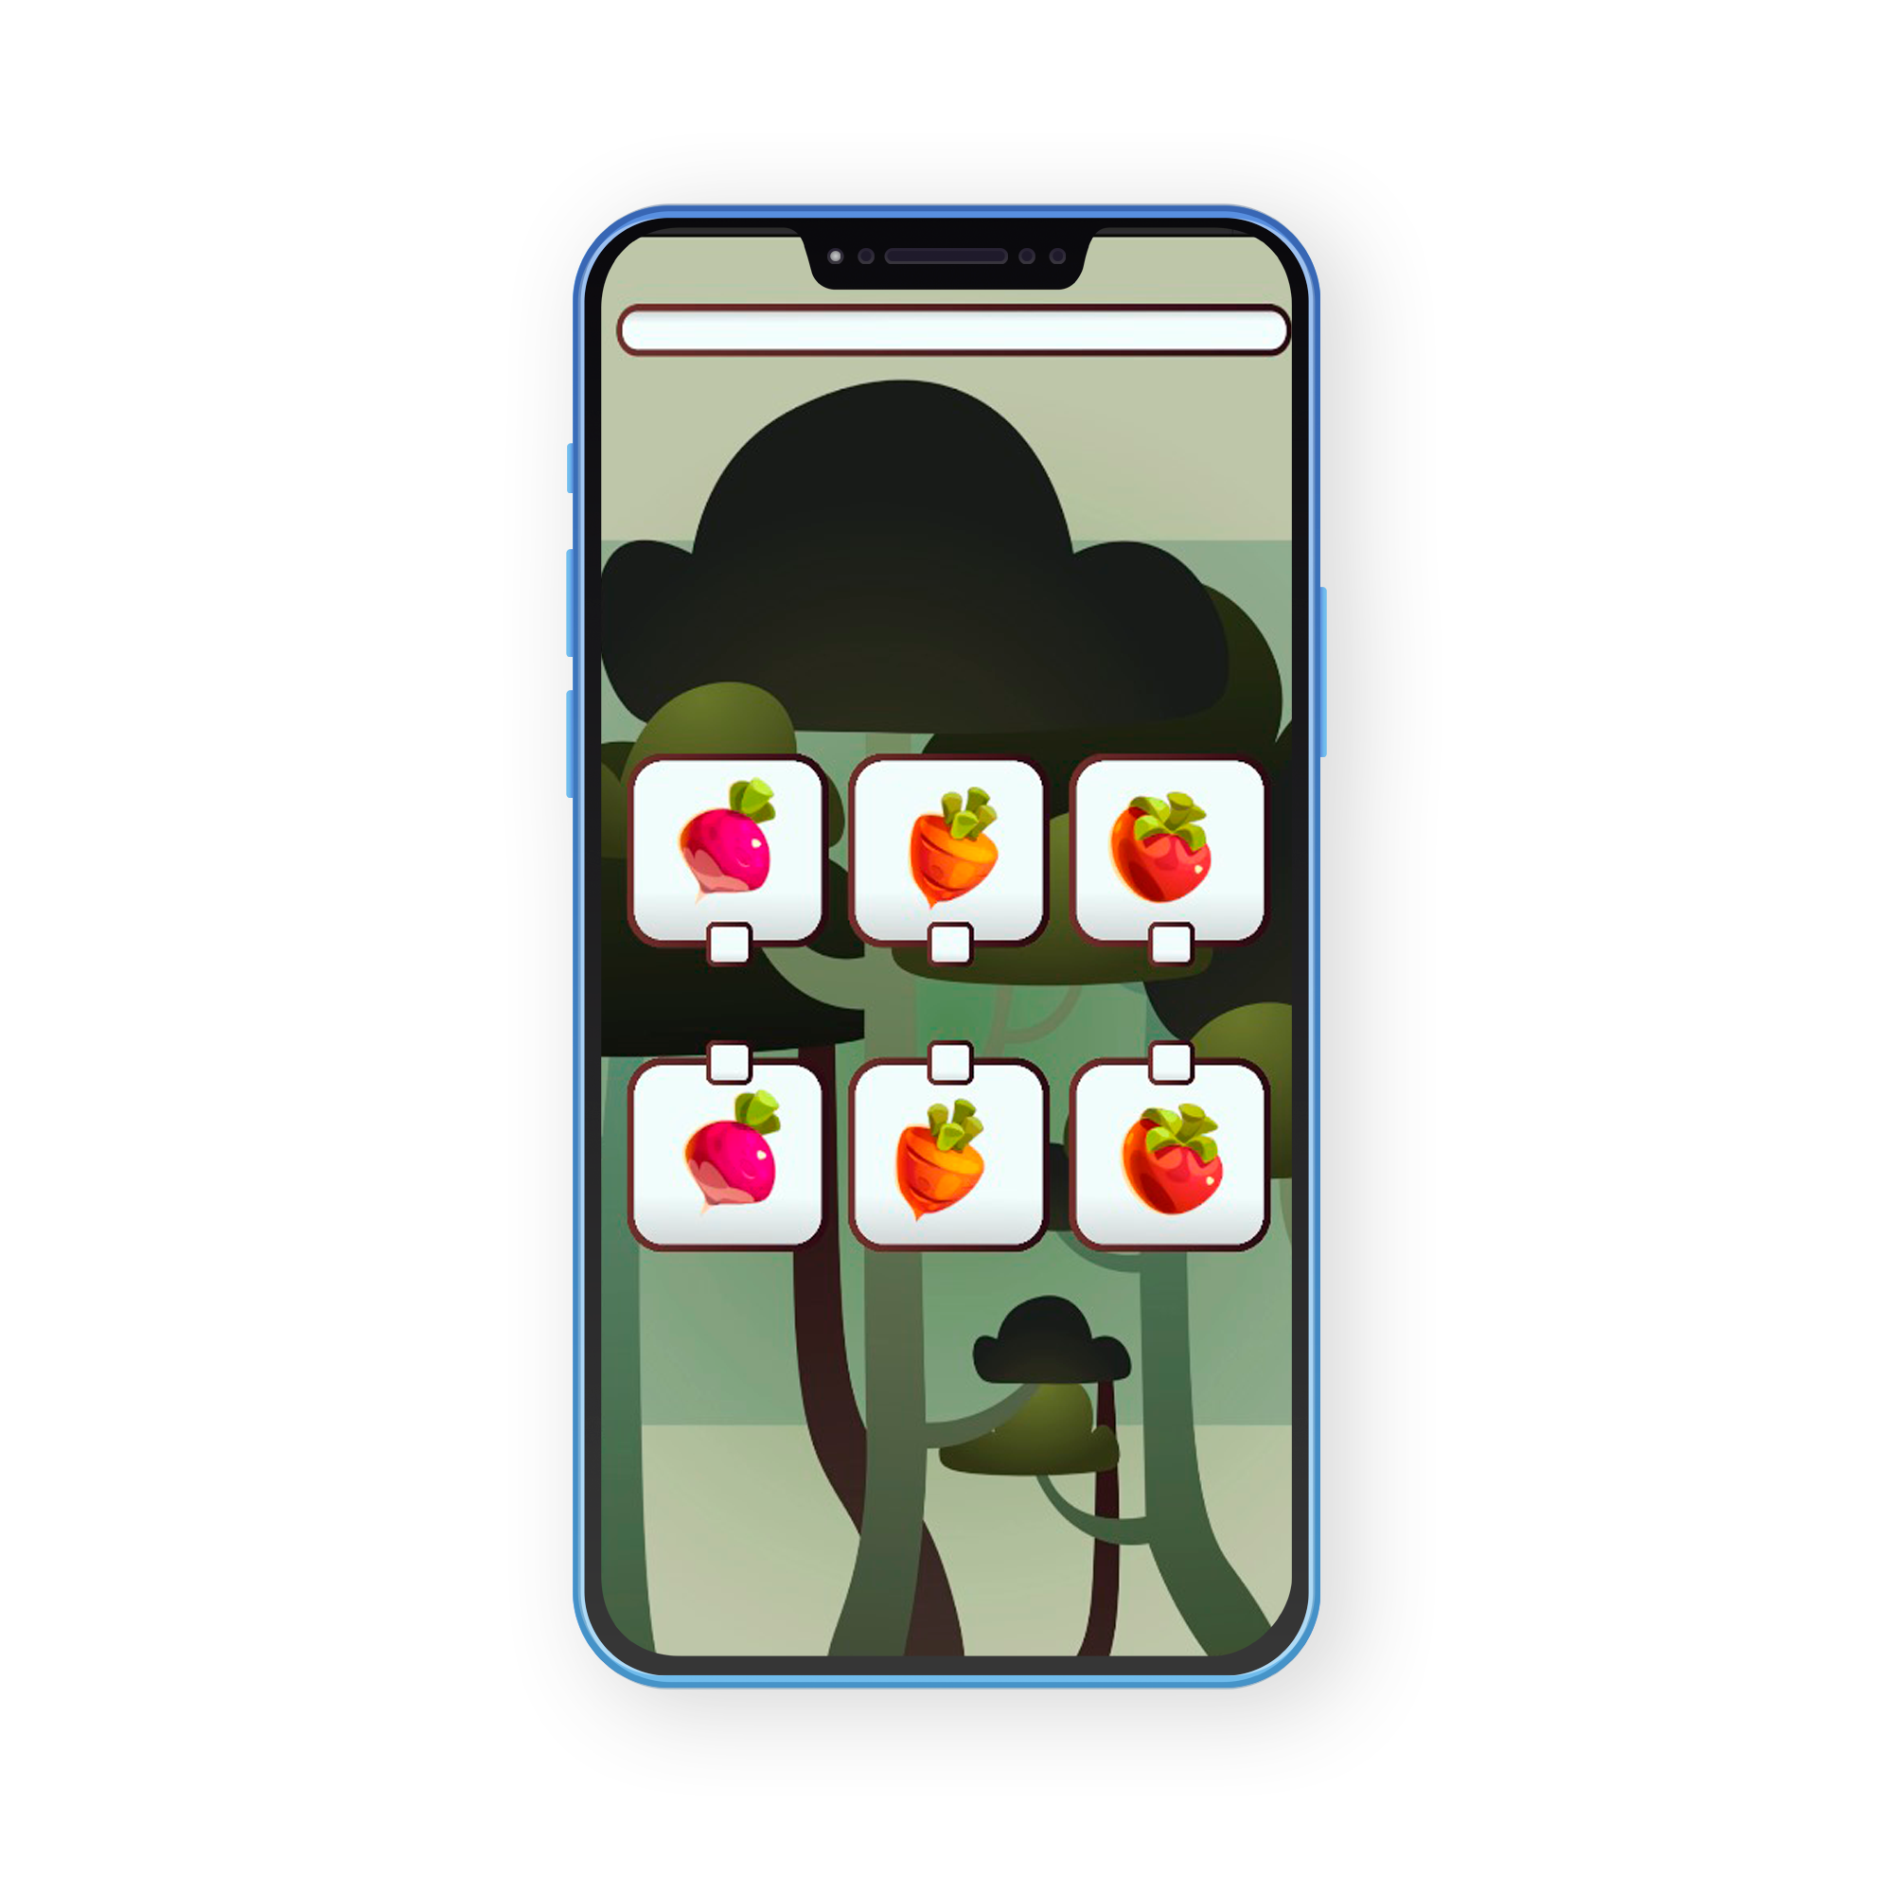
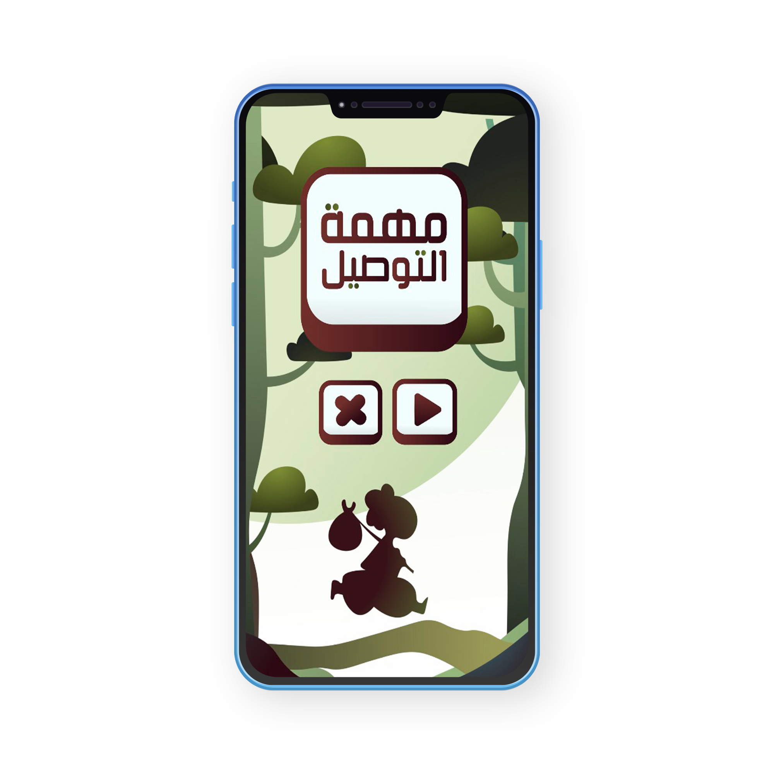
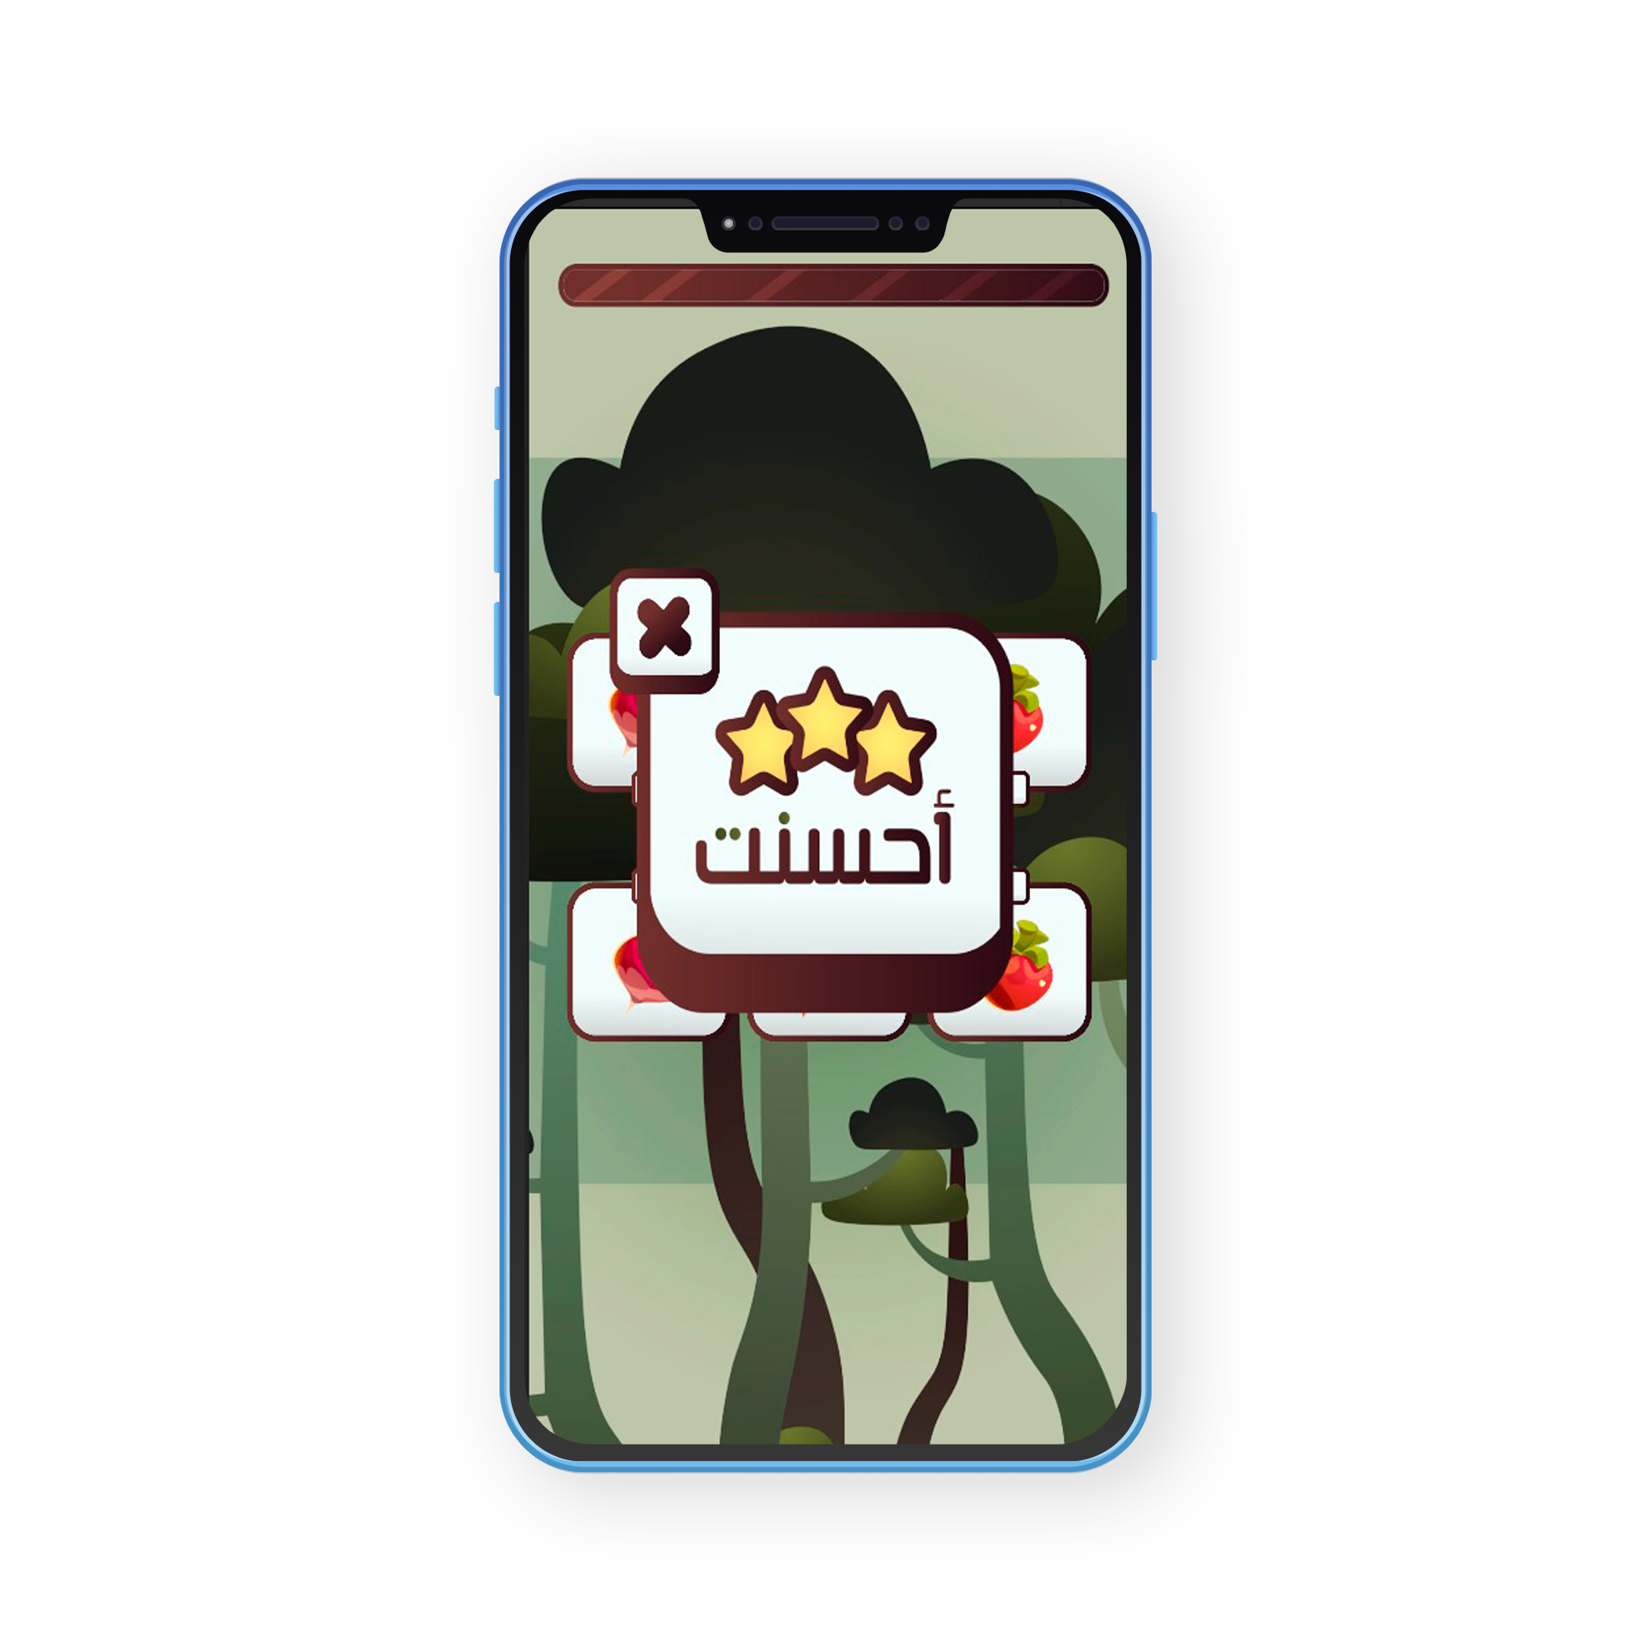
Matching Game

Slide 35
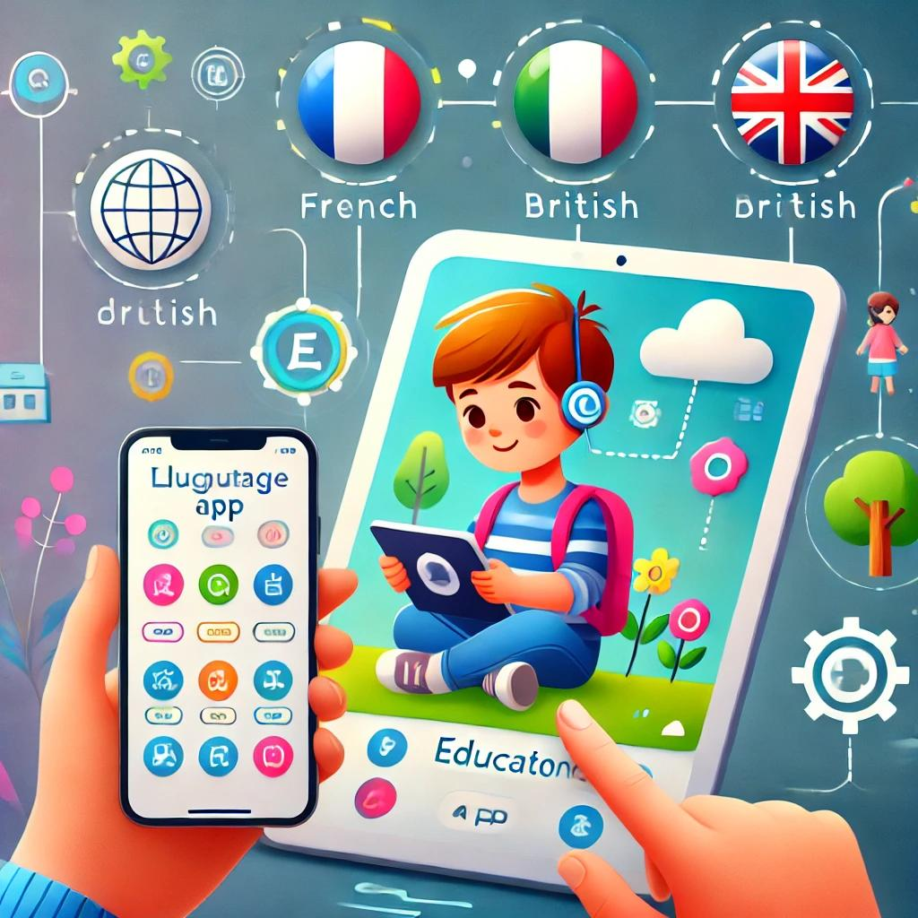
Future work
Add support for more languages (e.g., English, French) to promote language learning.
Link child and parent accounts to track progress and provide personalized support.

Slide 36
The End

